Slide 1
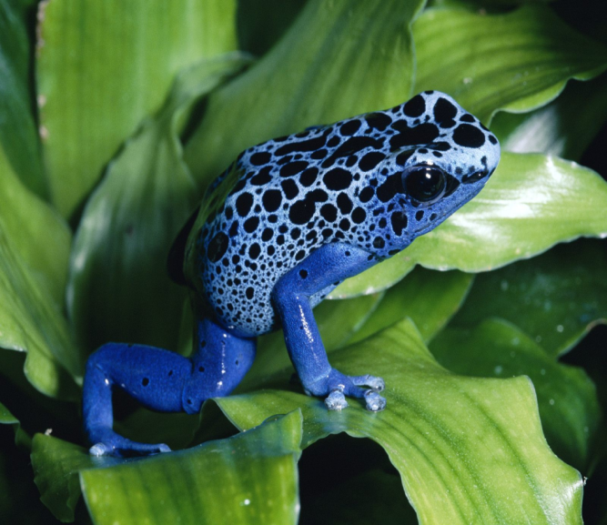
Good Morning Class!
Welcome to second grade! We have so much to do today; it is going to be a frog-tastic day!
Do not open any of your supplies.
Sit at your desk.
Do the paper.
If you finish, read the magazine.
Frog Fact! There are over 4,700 different species of frogs. Frogs can be found on every continent except for Antarctica. Why do you think frogs aren’t found there?

Slide 2
Good Morning Class!
When you enter the room…
Bring Miss Ploutz your planner and homework folder.
Make your lunch choice
Put away your book bag
Do your Morning Work.
When you finish, read your magazine.
Frog Joke! What did one frog say to another frog about the books in the library?
I already
read-it, read-it, read-it!

Slide 3
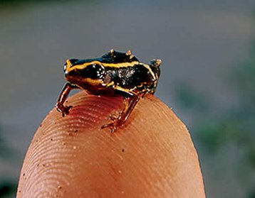
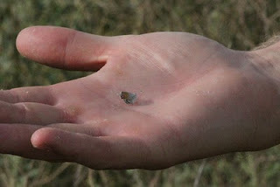
Good Morning Class!
Happy Monday!
Bring Miss Ploutz your planner and homework folder.
Make your lunch choice
Put away your book bag
Do your Morning Work.
When you finish, read your book.
This is the world’s smallest butterfly. It’s name is the Western Blue Pygmy (pig-me) butterfly.

Slide 4
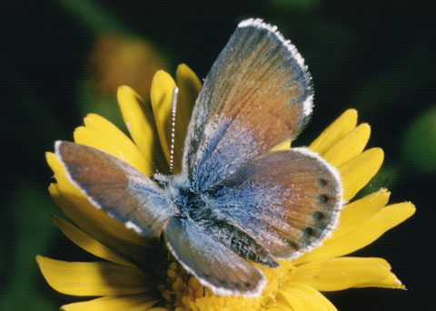
Good Morning Class!
Happy Monday!
Bring Miss Ploutz your planner and homework folder.
Make your lunch choice
Put away your book bag
Do your Morning Work.
When you finish, read your book.
This is the world’s smallest butterfly. It’s name is the Western Blue Pygmy (pig-me) butterfly.

Slide 5
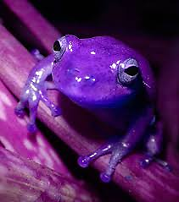
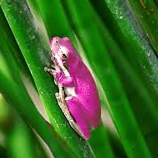
Good Morning Class!
Happy Friday!
Bring Miss Ploutz your planner and homework folder.
Make your lunch choice
Put away your book bag
Do your Morning Work.
When you finish, read your book.
Frogs come in many different colors.
Did you know there are purple and pink frogs?

Slide 6
Good Morning Class!
Happy Wednesday!
It’s time to get messy, make mistakes, and be scientists! Are you ready for Super Science Day Part 2?
When you finish your Morning Work, you may…
Read a book at your desk
Sharpen your pencils
Play Math Bump in the pond
Use an iPad at your desk
Did you know it often takes hundreds of trials before an experiment works. How many different times did you have to rebuild your tower yesterday?

Slide 7
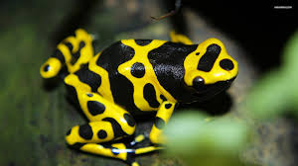
Good Morning Class!
Happy Thursday!
We have a lot to do today so we will be ready for Field Day tomorrow. Make sure you have your science book handy because we are turning them in today.
When you finish your Morning Work, you may…
Read a book at your desk
Sharpen your pencils
Play Math Bump in the pond
Use an iPad at your desk
Did you know the smallest Poison Dart Frog is only ½ of an inch long. That is one tiny colorful froggie!

