Slide 1
All About Frogs
By:

Slide 2
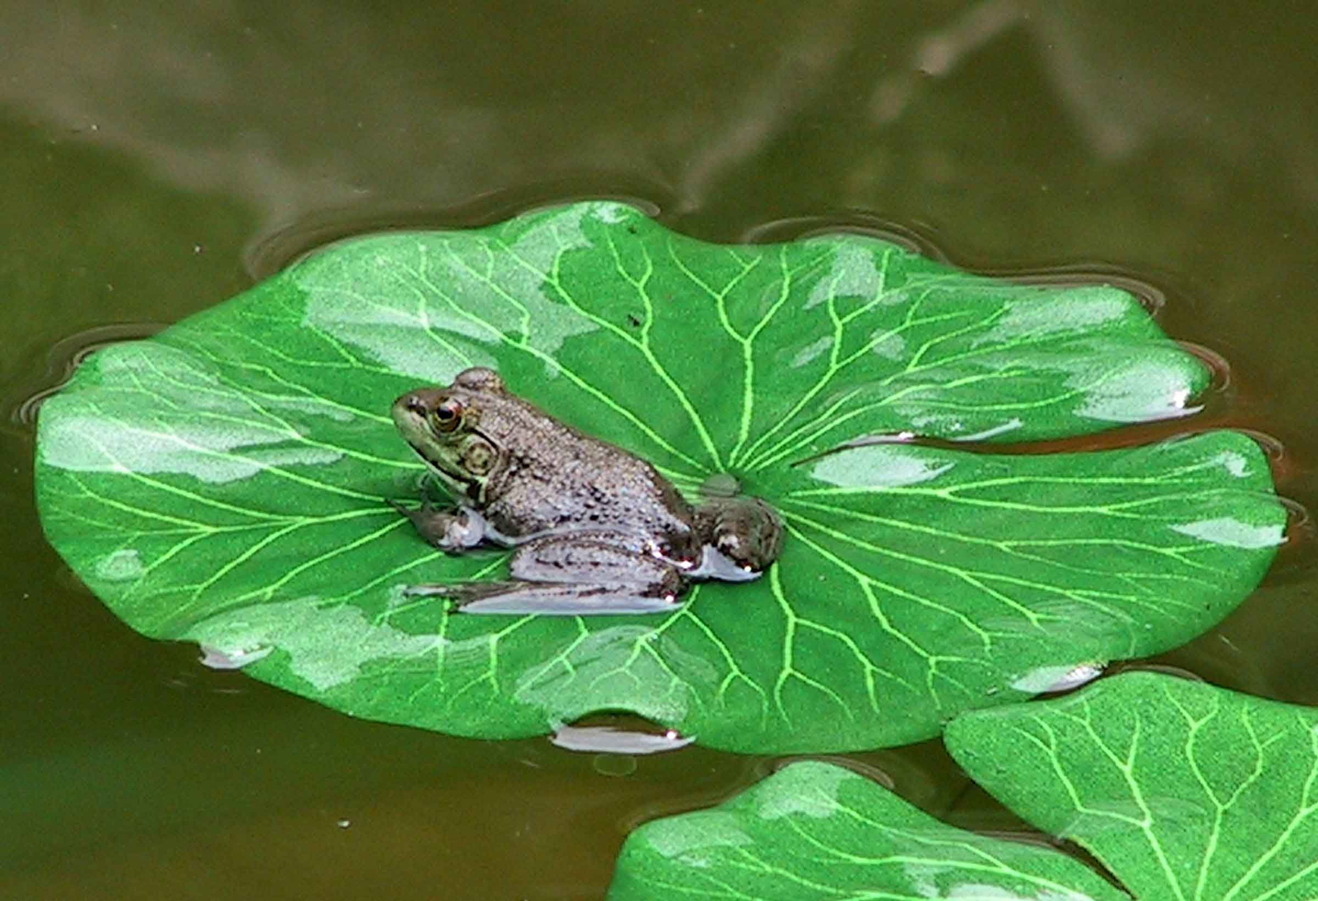
What are frogs?

Slide 3
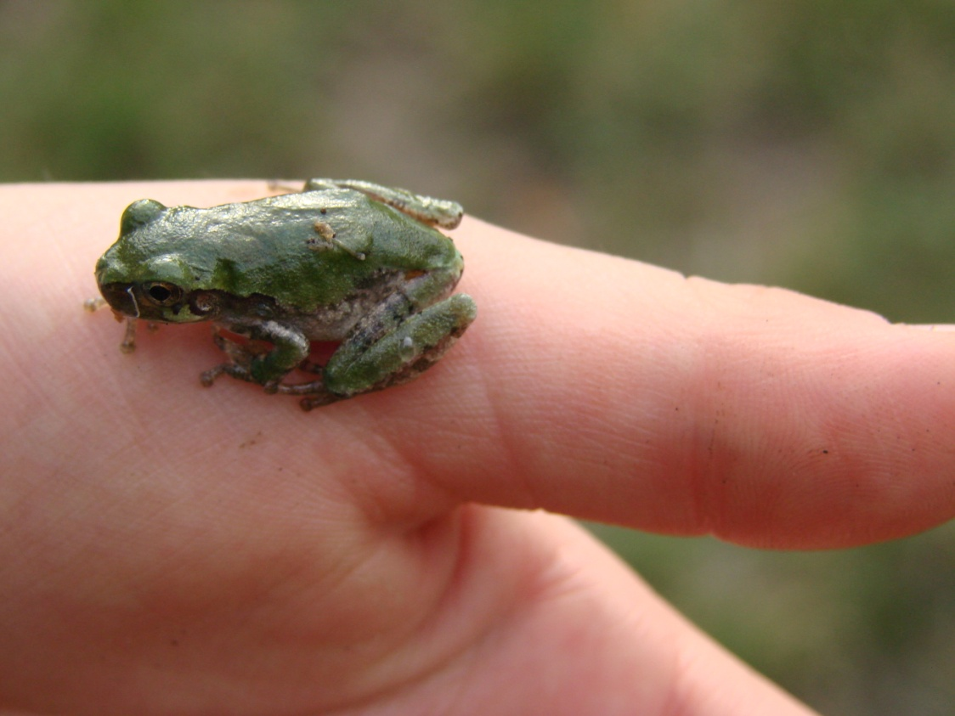
What do frogs look like?

Slide 4
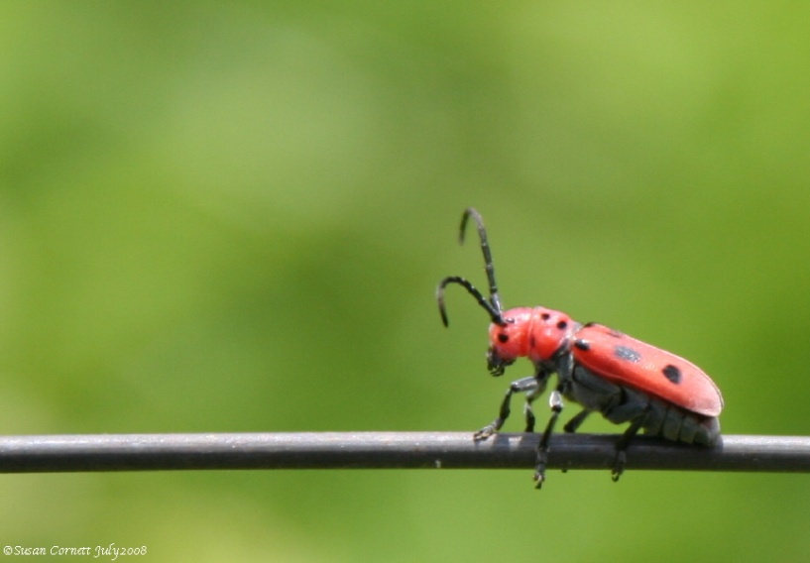
What do frogs eat?

Slide 5
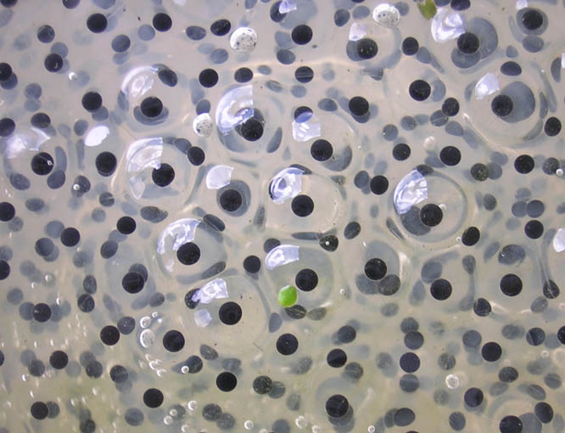
Frog Life Cycle - Egg

Slide 6
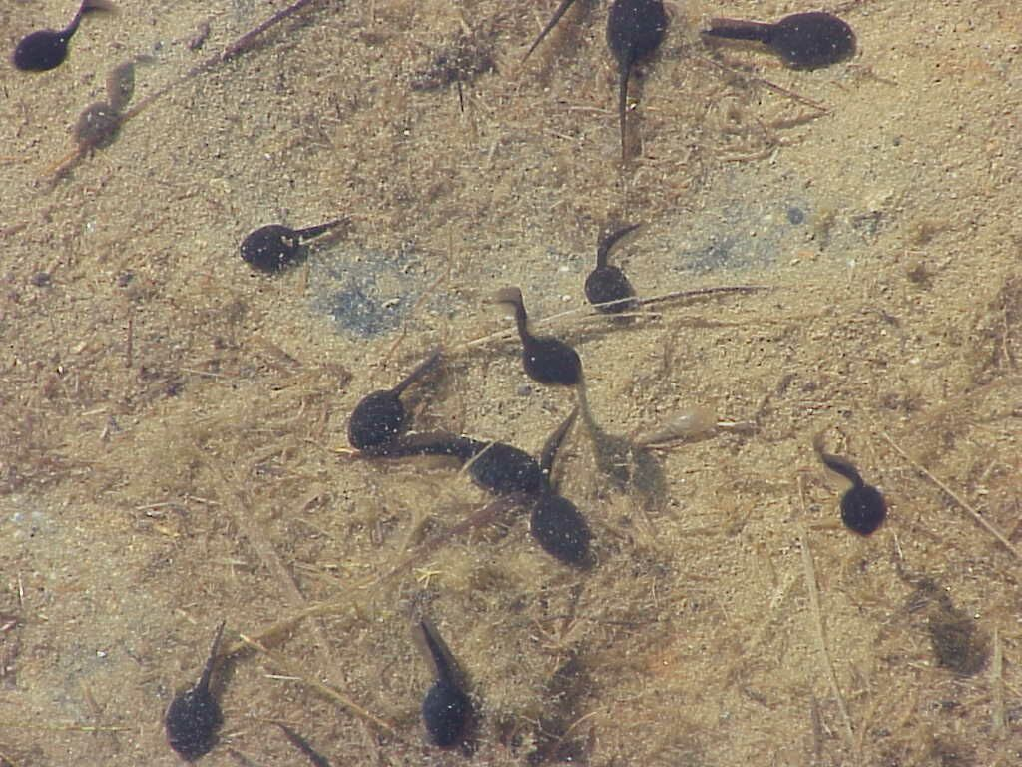
Frog Life Cycle - Tadpole

Slide 7
Frog Life Cycle - Froglet

Slide 8
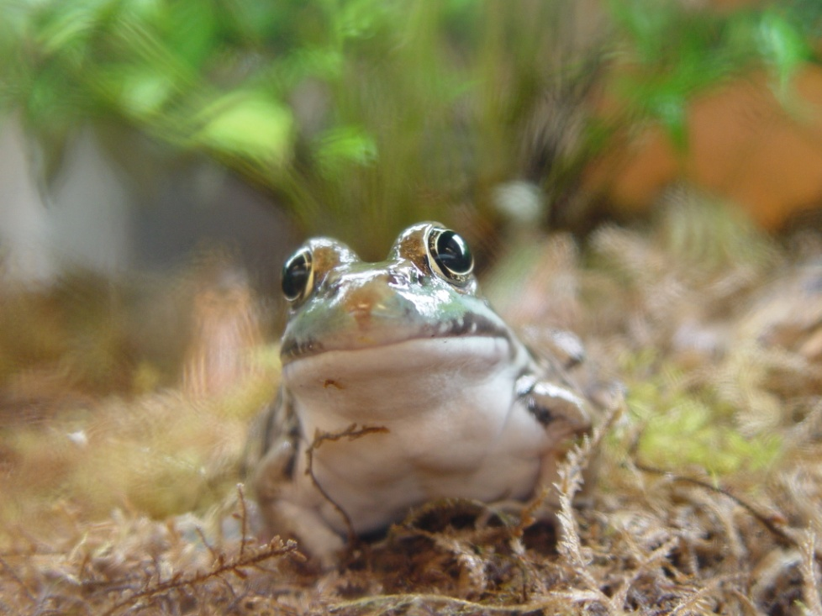
Frog Life Cycle – Adult Frog

Slide 9
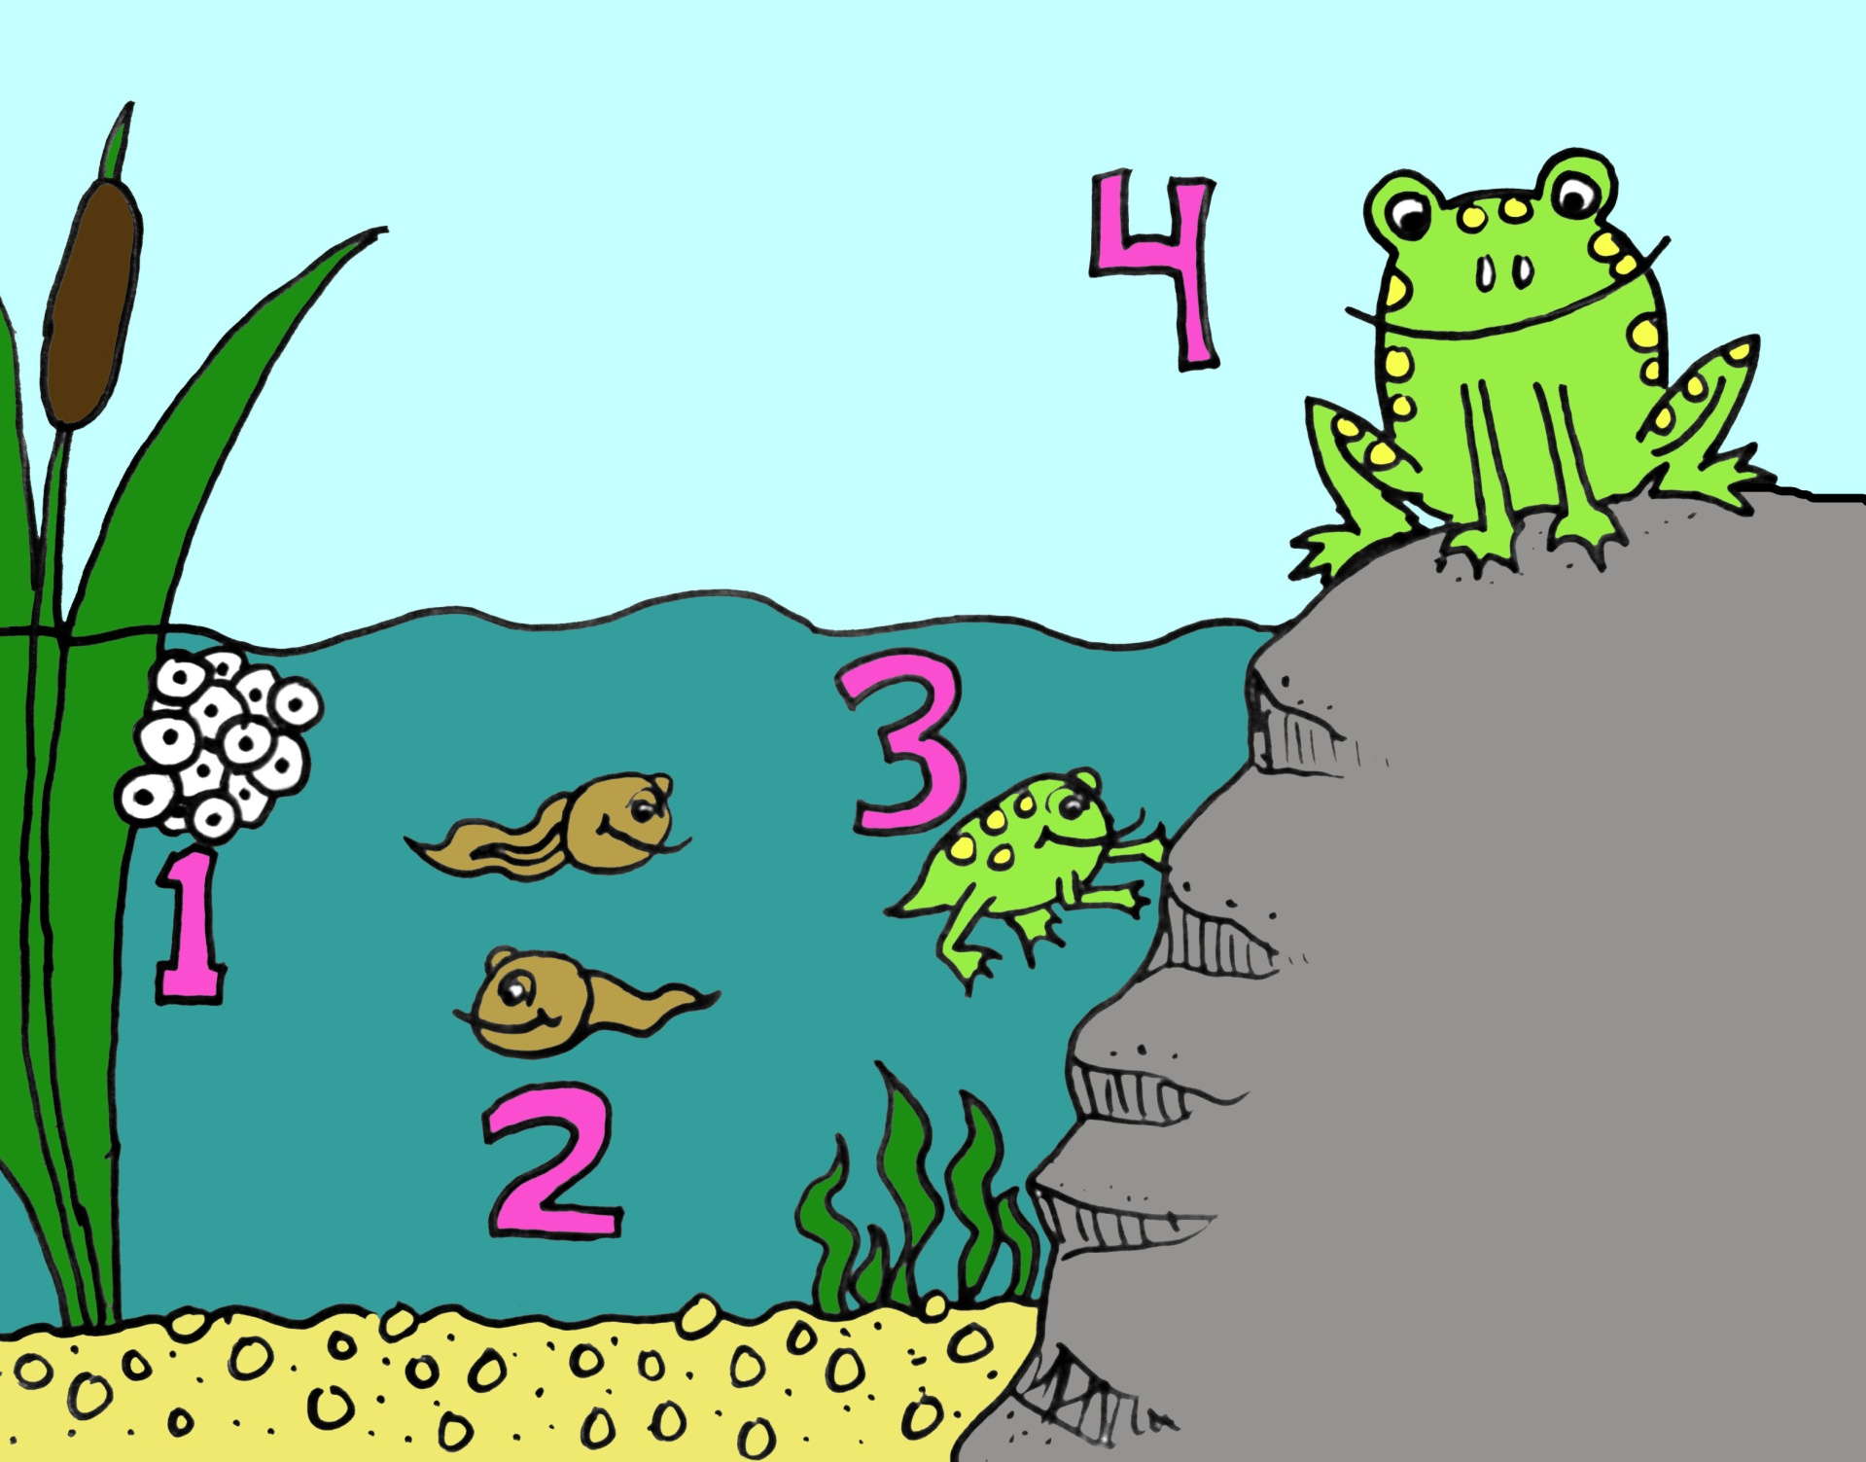

Slide 10
Frogs truly are fantastic amphibians!

