Slide 1
iPad Rules

Slide 2
Be Safe

Slide 3
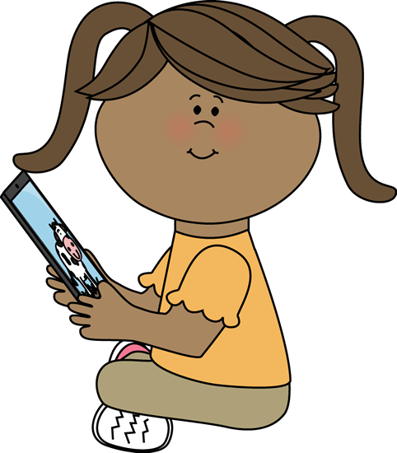
Be Safe
Use two hands
Sit while you use it
Return it when finished

Slide 4
How can you be safe with an iPad?

Slide 5
Be Responsible

Slide 6
Be Responsible
Use the appropriate apps
Have clean hands
Speak with the teacher if you have a problem

Slide 7
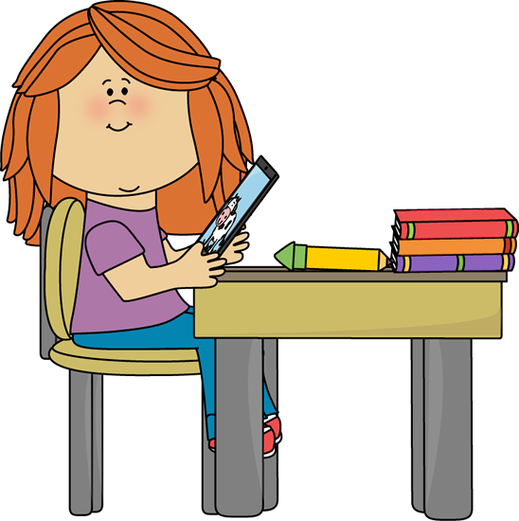
How can you show responsibility with an iPad?

Slide 8
Be Respectful

Slide 9
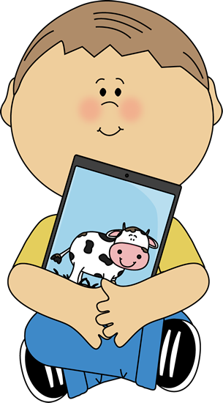
Be Respectful
Monitor your time
Monitor the battery level
Use gentle hands
Keep the iPad clean

Slide 10
How can you show respect when using an iPad?

Slide 11
What are the iPad rules?

Slide 12
Now you know how to take care of our class iPads!

