Slide 1
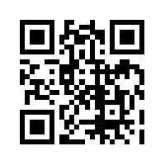
Please go to:
www.
missploutz.
weebly.com
Feel free to look around,
then click on Tech.

Slide 2
Making Tech
Work for You
In a Primary Classroom

Slide 3
Turning your classroom into a Blended
Learning
Environment
can be nerve wracking at first,
just remember rule number 1. . .

Slide 4
*Don't be afraid to let kids explore, they already have a no fear attitude when it comes to technology. They are always excited to try something new!
*They will probably figure out short cuts and new things before you do.
*Class Job:
Tech Guru

Slide 5
What
is a
Blended
Classroom?

Slide 6
Morning Message
I start everyday with a Morning Message.
> I used to write them out on big paper, then started running out of it and my corporation was no longer purchasing the books.
> Students start everyday reading
> Inform students of schedule changes
> I was becoming irritated with the paper
> This is when I started using Power Point
and I LOVE it!
> See Samples!

Slide 7
Morning Work
Alternative Morning Work
> Everyone has their own version of Morning Work
> Most recently I was using an awesome paper version by Second Story Teacher (Link Below)
https://www.teacherspayteachers.com/Product/2nd-Grade-Common-Core-Morning-Work-256434
> Three years ago, I began to see the possibilities of Morning Work time.
> This is how I created “Alternative Morning Work!”

Slide 8
Alternative Morning Work
> Make a list of who needs what
> Make a priority list
> Also, give them choices
> Needs aren’t ‘set in stone’ so their Morning
Work shouldn’t be either
> I update my Morning Work once a month
> If they don’t follow
the rules . . .
> See Samples

Slide 9
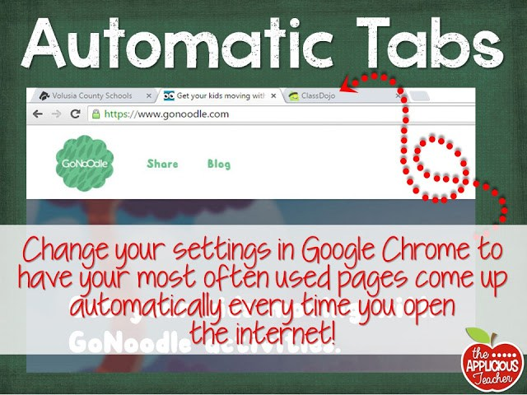
Chrome Automatic Tabs

Slide 10
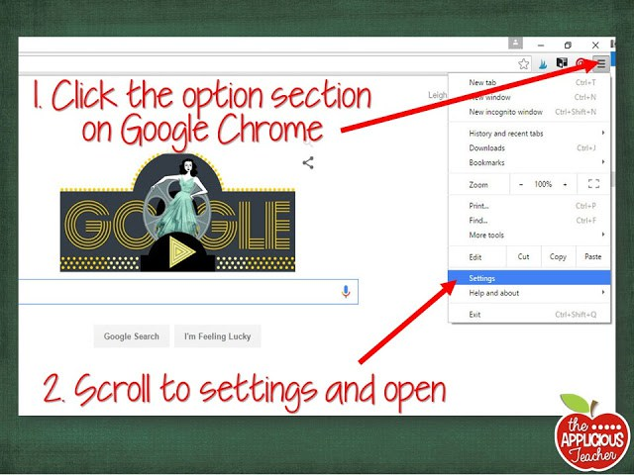

Slide 11
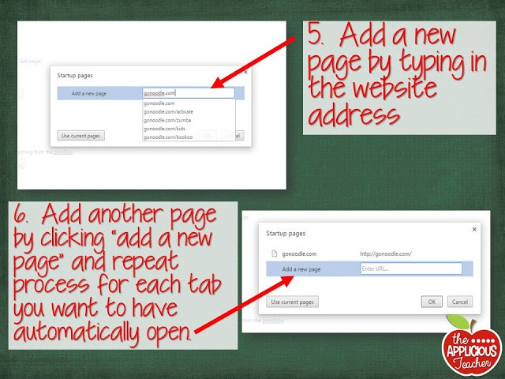
Screenshots from The Applicious Teacher Blog

Slide 12
Classwork
> www.mathfactcafe.com
> www.education.com
> 10 free a month or get a subscription
> Why spend your valuable time searching
for the perfect worksheet, when you can make exactly what you want?
> See Samples

Slide 13
Using Tech During Stations
> What are your stations?
> What do you do during stations?
> Give them choices
> I was tired of kids loosing pieces
to the paper folder games, so I
decided to down-size and do a
major tech up-grade to my stations.
> Having a class page will give your
students easy access to sites.

Slide 14
What my student iPads look like
Pictures

Slide 15
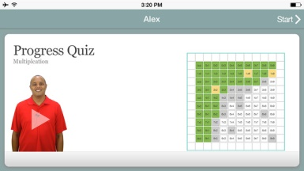
Must Use Apps
* Spelling City
> Must have a subscription to have full access to everything
*AR
>Must have a subscription to use
*Xtra Math
>$4.99 for App, Site is Free
*Brain Pop (Brain Pop Jr, Brain Pop ESL)
>Free video of the week, get the subscription for full access to all videos at any time

Slide 16
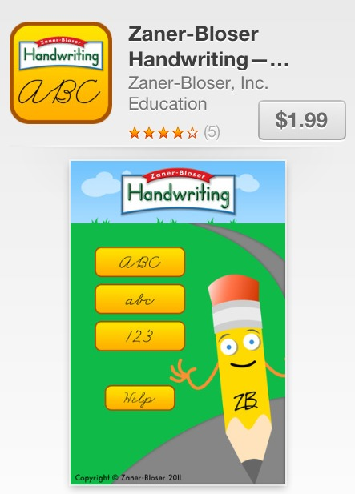
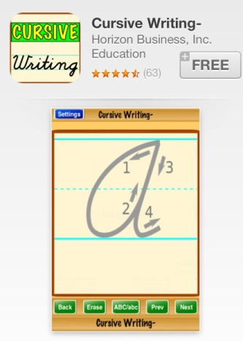
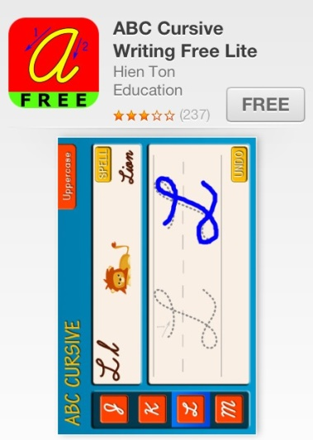
Handwriting-Cursive
*Zaner-Bosser- $1.99
*Cursive Writing- FREE
* ABC Cursive Writing FREE Lite

Slide 17
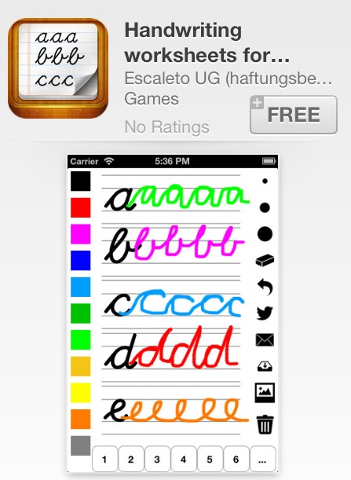
Handwriting-Cursive
*Handwriting Worksheets- FREE

Slide 18
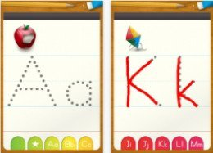
Handwriting - Print & Cursive
*ABC Letter Tracing Alphabet-FREE

Slide 19
Q R Codes
* What are QR Codes?
*Make your own QR Codes. . .
www.qrstuff.com
* Get a QR Reading App
*Try Out QR samples!

Slide 20
Make Your Own “App”
* Do you have a site you LOVE to use, but it doesn’t have it’s own app?
*Make it into an “app!”
>Use Safari
>Go to the site
>Click on
>Tap “Add to Home Screen”
>Name it
>Ta-dah!

Slide 21
Stations Tech- Student Computers
> Make you life easier with a class web page!
> Is it student, parent, and teacher friendly?
> Think like a ___ grader when setting up your student pages.
> Then think like a parent of a __ grader when setting up your page.

Slide 22
Your Class Web Page
> Is it student, parent, and teacher friendly?
> Think like a ___ grader when setting up your student pages.
> Then think like a parent of a __ grader when setting up your page.

Slide 23
Your Class Web Page
www.weebly.com
> As simple as drag, drop, and type
www.teacherspayteachers.com
> Clip art and fun fonts
> Check out their pages

Slide 24
Your Class Web Page
> Get permission to post student names and photos!!
> Check with your office staff
> See Web Page Permission file
> What if a parent says no for their name?
> What if parents say no to their photo?

Slide 25
Your Class Web Page
> When setting it up, ask yourself…
> Is it easily maintained?
> Does it display the important things?
> So many questions!
> 5 or less sentence rule
> Also applies to e-mails
> Speaking of which. . .

Slide 26
Parent Communication
> Parent-Teacher-Student Communication
> www.remind101.com
> Make an E-Mail Parent Contact group
> To: Yourself
> BCC: Parent Contact List
> They can’t see or e-mail each other, only you
> Easy Communication & Newsletters

Slide 27
Parent Communication
> Teach your children your class web address, don’t just teach them to click on the link
> First switch - 24% to 84%
> Last year: 27/29!! This year: 24/25 kids!!
> Blended families LOVE the e-mail communication & web page!

Slide 28
My Favorite Sites for Stations
Subscription Needed. . .
> IXL www.ixl.com
>app and site
> Spelling City www.spellingcity.com
>app and site
> Scholastic Reader http://sni.scholastic.com/sn2
>”magazine” app and site
> Accelerated Reader, app and site
>app and site

Slide 29
My Favorite Sites for Stations
No Subscription Needed
> See Ribbit Resources

Slide 30
How I Use Art Apps
> Pictures

Slide 31
Small Group Reading
Turn your reading/literacy groups in to interactive learning adventures!
> What concept are you trying to teach?
> How can you make technology work
for you?

Slide 32
Small Group Reading
Consider using. . .
> Power Point
` See Samples
> Tagxedo
> www.MagicTreeHouse.com
> A presentation app
` See Next 2 Slides

Slide 33
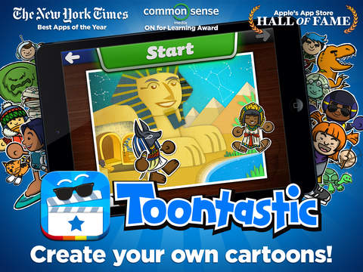
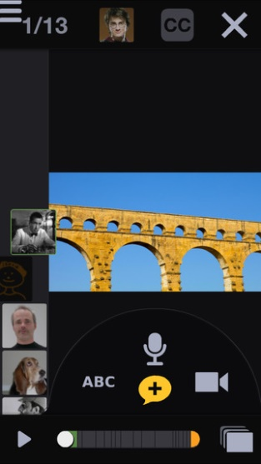
Presentation
Puppet Pals- FREE
>Students can animate and record audio to go along with their writing
Sock Puppets- FREE
>Students use sock puppets and their own voice to read
bring their story to life
Toontastic- FREE
> Students can animate and record audio
Voicethread- FREE
> Students can have ‘Book Talks’ and conversations about text that is displayed on the screen.
> They can even draw on the screen and add text to text bubbles.

Slide 34
Presentation
Telligami FREE & Paid Version
*See sample on webpage
*Kids LOVE this
* I use for book response & answering comprehension questions
* I have the kids share their Telligami’s using the e-mail option
> Free version- limited clothing & background options
> Record up to 30 seconds of dialog
> Paid Version
> They can even draw on the screen and add text to text bubbles.
> More clothing, avatar, and background options, and longer record time

Slide 35
Math-tastic!
> Small Group Math?
> Math Stations?
> Quick and easy way
to differentiate!
> Check out Apps list

Slide 36
Math Apps
> Pictures

Slide 37
Computer Lab
Turn your
computer lab time
into
COMPUTER LAB
TIME!

Slide 38
Prep Work
*Get in the “I can do this” mindset
*Class Page www.weebly.com
*Challenges
*Choosing a time
*Stick To It! Consistency= ☺
*Computer Troubles
*Set Your Rules
*Keep it simple!

Slide 39
Rule Sample Pages!

Slide 40
It’s Computer Lab Time!
> Talk through it before you go
> Make a list (5-6 steps maximum)
Open the internet.
Type www.missploutz.weebly.com
Do this task.
Or choose one of these tasks

Slide 41
It’s Computer Lab Time!
> Make up index cards with your class web address on them, laminate them, hole punch a corner, and keep them on a ring or have a website card basket
> Once you are lined up, review the rules and your task for the day

Slide 42
Class Tech Guru(s)
> Tech Savvy Student Helper(s)
> May very from class to class
> Getting an extra set of eyes and hands at the beginning of the year would be perfect
> Parent helper
> IA
> Student

Slide 43
What to Expect
> Lab time is like, a roller coaster that slowly turns into the old fashion cars ride at an amusement park
> Keep Calm and Teach On
> Students will mimic what they see in you

Slide 44
Learning the Language
> Remember the first time you ever baked a cake? Tried to crochet/knit/sew something?
> Repetition
> Talk through it
> More than the one student you
are talking to will hear it
> If you give a man a fish. . .

Slide 45
,mn
Using Microsoft Word
> Samples

Slide 46
Using Power Point
> Samples

Slide 47
Remember. . .
> What is your end goal?
> How could I go about that in a fun and educational way?
> Let the Tech work for you!
> Keep Calm and Teach On

Slide 48
Contact Information
Amber Ploutz
aploutz@gws.k12.in.us
www.missploutz.weebly.com

