Slide 1
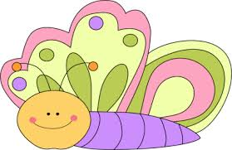
_______knows the parts of speech!

Slide 2
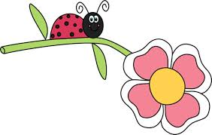
Common Noun
A noun is a person, place. or ______
Here are some nouns:
______, _______, _____

Slide 3
Proper Noun
A proper noun is a __________ person, place, or thing.
Here are some proper nouns:
______, _______, _____

Slide 4
Verbs
It’s a verb! It’s a verb! It’s an action word, if you can do it __________________!
Here are some verbs:
______, _______, _____

Slide 5
Adjectives
Adjectives are words that describe nouns.
Here are some adjectives:
red
soft
__

Slide 6
Synonyms
Are two words that have the same meaning.
Here are some examples:
Chilly = _____ Dish= ______
Huge= _______ beautiful= ______

