Slide 1
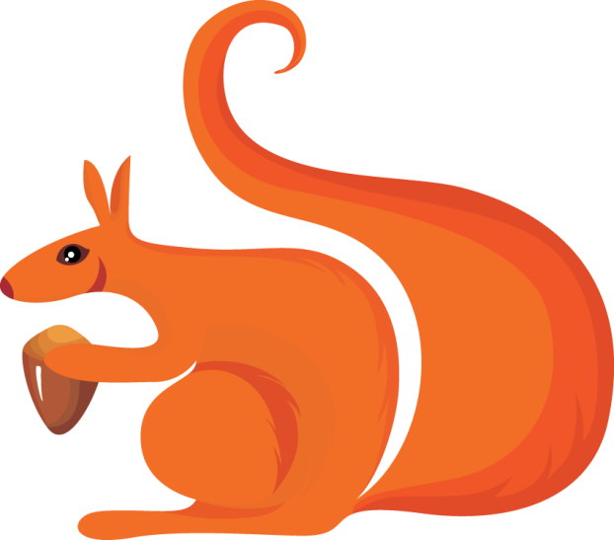
_______knows the parts of speech!

Slide 2
Common Noun
A noun is a person, place, or thing.
Here are some nouns:
______
_______
_____

Slide 3
Proper Noun
A proper noun is a specific person, place, or thing.
Here are some proper nouns:
__
__
__

Slide 4
Verbs
It’s a verb! It’s a verb! It’s an action word, if you can do it __________________!
Here are some verbs:
__
__
__

Slide 5
Adjectives
Adjectives are words that describe nouns.
Here are some adjectives:
red
soft
crunchy

Slide 6
Synonyms
Are two words that have the same meaning.
Here are some examples:
Chilly = _____ Dish= ______
Huge= _______ Beautiful= ______

