Slide 1
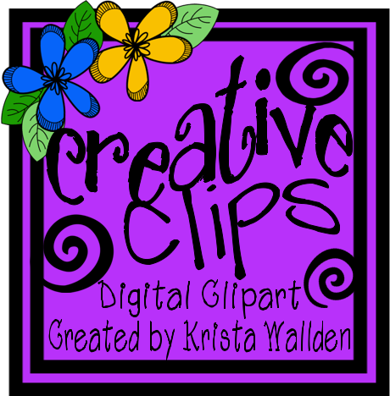
Pencil Morning Messages
Featuring Clipart from:

Slide 2
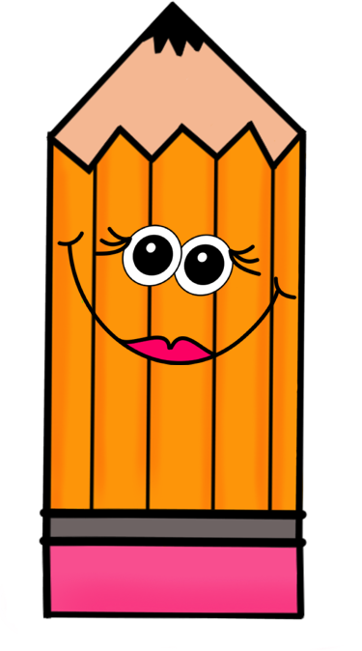
Good Morning Class,

Slide 3
Good Morning Class,

Slide 4
Good Morning Class,

Slide 5
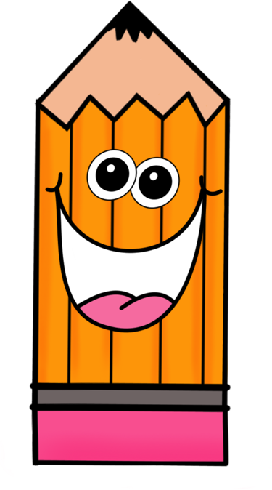
Good Morning Class,

