Slide 1
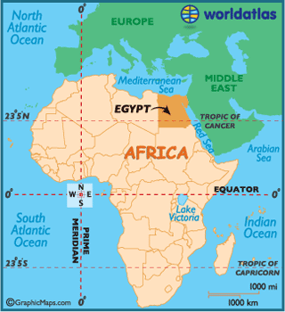
All About…Ancient Egypt
By: Student

Slide 2
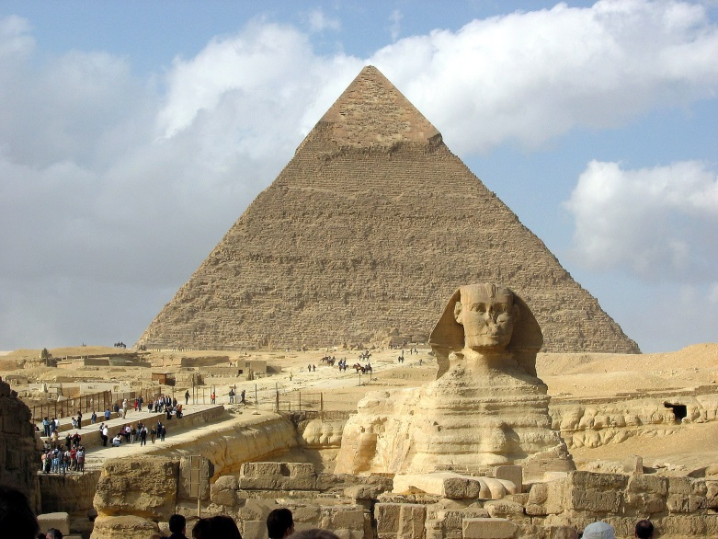
Every Day Life
Most people in Egypt where farmers.
Every child in Egypt did not wear clothes.
Every Egyptian boy and girl wore their hair on the side called side locks.

Slide 3
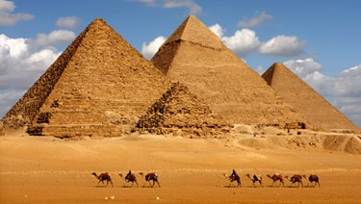
The Age Of Pyramids
The very first pyramid was made by Imhotep.
Imhotep has a pharaoh is name was King Dozer.
That would be the biggest Mastaba in Egypt.

Slide 4
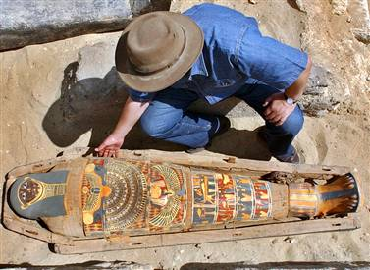
Mummies
In Ancient Egypt when people died they put them in a case and they decayed.
They took the organs out of the body except for the heart.
They had to weigh the heart and it tells them if they had a great life.

Slide 5
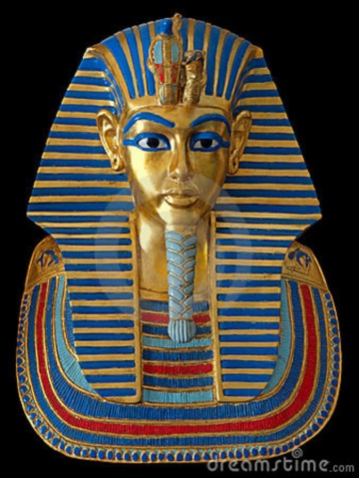
Howard’s Tomb
The people who built tombs from the valley of kings tried to keep them safe.
No one could find Howards tomb.
He put his treasures in the museum in America, but he wouldn’t tell them were the tomb was hidden. He was trying to keep the tomb safe.

Slide 6
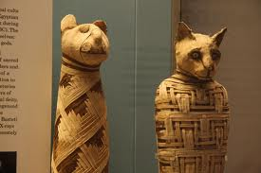
Tomb Treasures And Tomb Robbers
The people who died had extra things like writing materials they where also buried with shoes to.
They put all of there stuff in there because they wanted to have it.
They thought they would have all of the things they buried with them in the next life.
Some tombs had carts, boats, and food.

Slide 7
The End

