Slide 1
mummies
By: A Student

Slide 2
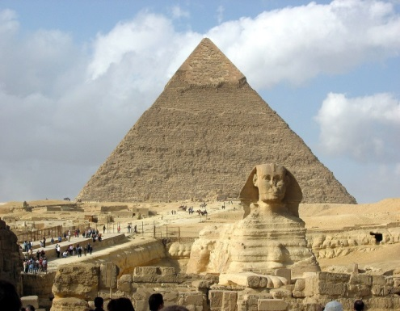
Everyday life
Most ancient Egyptians were farmers.
They lived in villages in the black land along the Nile.
Their houses where made out of mud bricks.
The mud was another gift from the Nile.

Slide 3
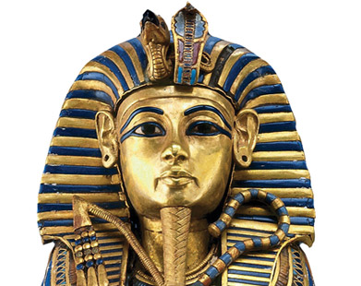
The most famous mummy
Pyramids were built for honor pharaohs and their families.
But pyramids also told tomb robbers exactly look for treasure .
Pharaohs cared more about their mummies safe their having huge pyramid.

Slide 4
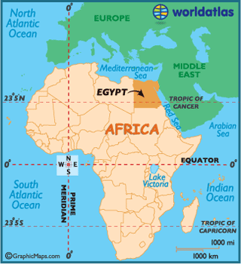
Ancient Egypt
For thousands of years mummies and pyramids where a great mystery.
How were the pyramids where built why did people make mummies?
They rolled the heavy blocks on logs to get them across the sand.
What was the strange writing on mummy cases?
It was Egyptian writing called hieroglyphics.

Slide 5
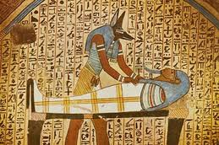
Egyptian funfairs
Egyptian funfairs where very big events.
They where meant to send people to the afterlife on the day the mummy was taken to its tomb.
They had a big parade that went from the person’s house all the way to their pyramid.

Slide 6
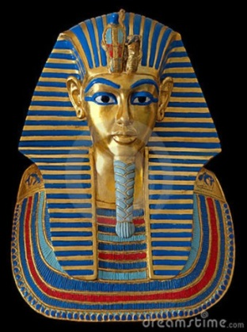
mummies
Normally when people or animals die the body begins to decay.
That means that the skin hair muscles and other parts of the body starts to rot away.
Finally everything is gone but bones.
But mummies are wrapped in linen and they do
not decay very much.

Slide 7
The End

