Slide 1
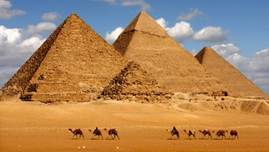
ALL ABOUT ANCIENT EGYPT
By: Student

Slide 2
Ancient Egypt
People who built pyramids were hardworking and enjoyed life.
The hardworking people loved science and music.
The Nile River is the longest river in the whole world.
The Nile River flow in the middle of Egypt.
The Nile gave water to drink and bathing.

Slide 3
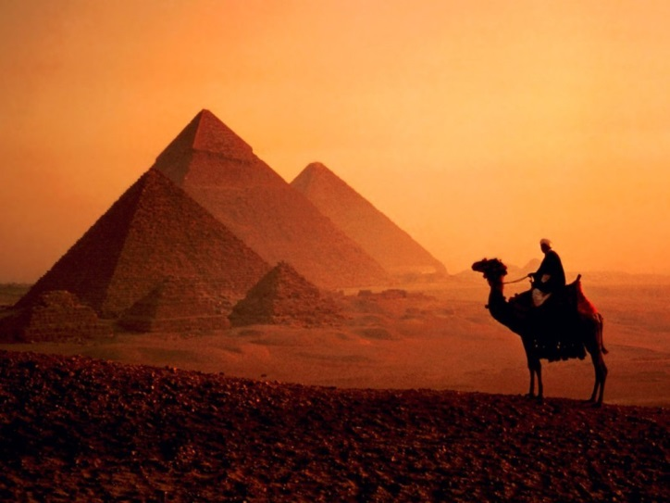
Everyday Life
Most Egyptians were farmers.
Most ancient Egyptian houses were made of mud bricks.
Families often cook food for their family on the roof.
Most ancient Egyptian did not have a lot of furniture.
Most walls in Egyptian houses
were bright colors.

Slide 4
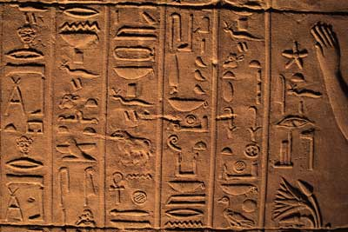
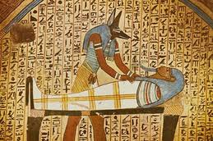
Egyptian Religion
Egyptians worshiped their pharaoh.
Egyptians also worshiped many gods and goddesses.
Ancient Egyptians pictured their gods and goddesses in several different ways.
Some were like ordinary men and women.
Few were like animals.

Slide 5
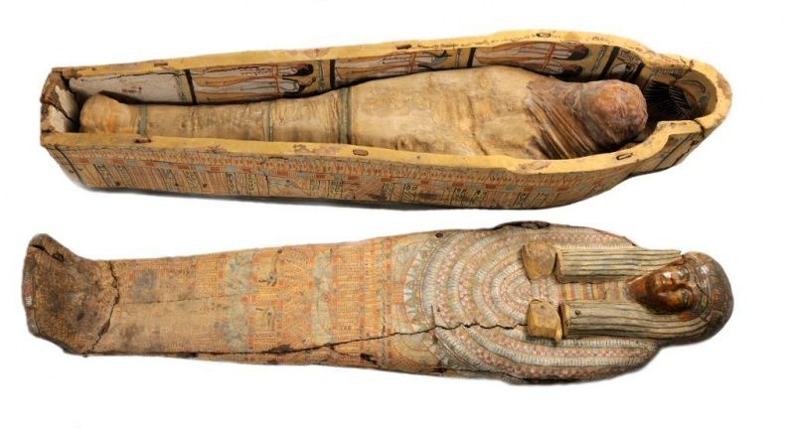
Mummies
When a persons body has been decayed there is only bones.
A mummy is protected from decay.
The first Egyptian mummy was made by accident.
The Egyptians needed the land near the Nile for farming.

Slide 6
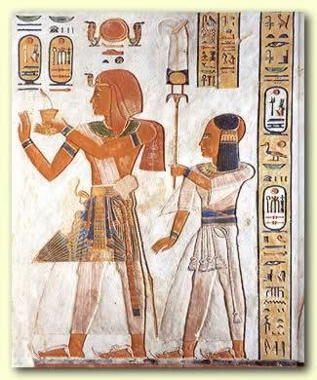
Tomb Treasures and Tomb Robbers
The mummies family wanted the dead to look their best in the next life.
The items buried with the mummies could be very valuable.
Every pyramid standing right now has been broken into by tomb robbers.
The Egyptians wanted to be as comfortable and happy in the Next Life as they had been on earth.

Slide 7
The End

