Slide 1
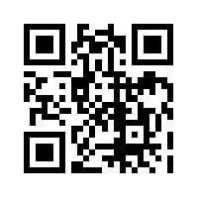
Please go to:
www.
missploutz.
weebly.com
Feel free to look around,
then click on Tech.

Slide 2
Using iPads
in a
Primary Classroom

Slide 3
Setting Up for Success
* Rules
`See examples
*Think about your rules and requirements
*Design your own rule list

Slide 6
*See Sample Rules Presentation

Slide 7
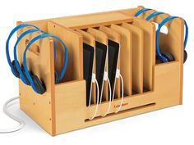
Charging Station/Center
*Do you have a charging station?
*50% battery level or less
*”Sleep It” to conserve the battery
*Tech Guru
*Lakeshore Sample
$149
*Check out less
expensive options

Slide 8
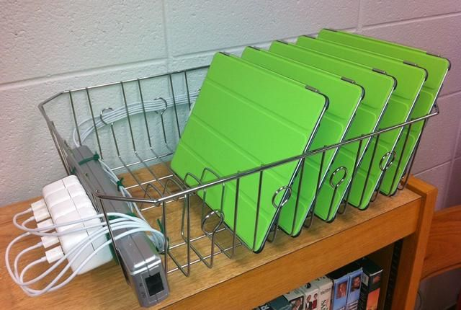
Charging Station
*Other Charging Possibilities

Slide 9
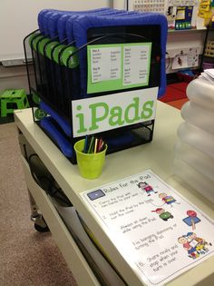
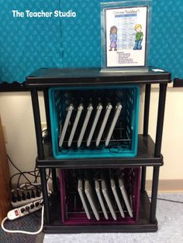
Charging Station
*Other Charging Possibilities

Slide 10
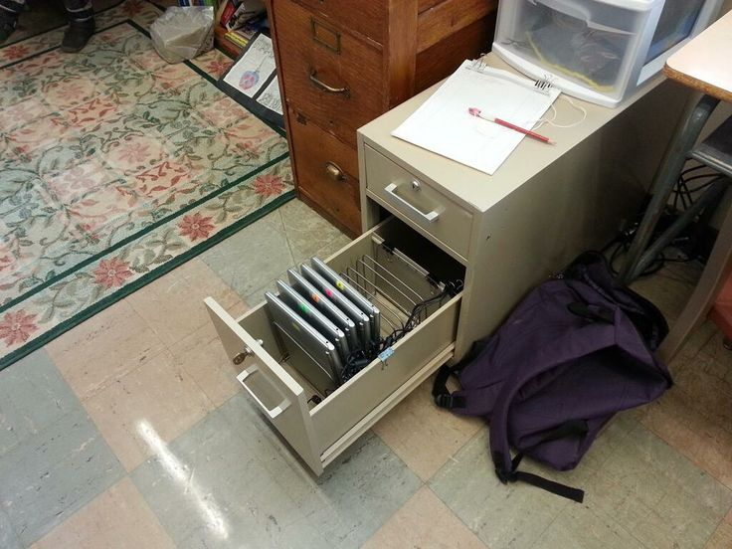
Charging Station
*Other Charging Possibilities

Slide 11
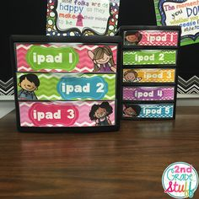
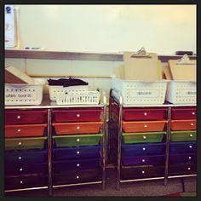
Where is the iPad’s Home?
*iPad Home

Slide 12
Updates
*Know before you go
*Monthly iPad Check Up
` First Monday of every month
` Update & add new apps
*Special iPads
` I name mine after the color of their cover
` Tech Gurus help to test out new apps

Slide 13
Sound?
*How will you handle sound?
>Know before you go
>My rule is . . .
` 1 block or with earbuds/headphones you
choose how many blocks
` NO blocks without earbuds/headphones
during Level 0 (our sound level chart)

Slide 14
A Kid-Friendly iPad
*Set up folders & label them - for the kids
*Set up “Quick Apps” for apps your students will be using on a daily basis
*Name or number your iPads

Slide 15
Let’s Do This!
*Introducing iPads to your class
` See class iPad presentation
*Slow and steady wins the race!
*Be specific & strict now, to allow for many more learning opportunities as the year progresses.

Slide 16
Blended Classroom In Action
*Students need to know. . .
* We are all learning by doing in different ways.
*What is my job?
*What is the teacher’s job?
*It is fun to have fun, but you have to know how.

Slide 17
What Does a Blended Classroom Look Like?
Video Clip

Slide 18
An App for Everything!
* Before we dive into the millions of amazing educational apps out there, keep in mind:
*What do my kids need?
*What am I trying to teach?
*What are we working on/towards?

Slide 19
Make Your Own “App”
* Do you have a site you LOVE to use, but it doesn’t have it’s own app?
*Make it into an “app!”
>Use Safari
>Go to the site
>Click on
>Tap “Add to Home Screen”
>Name it
>Ta-dah!

Slide 20
Q R Codes
* What are QR Codes?
*Make your own QR Codes. . .
www.qrstuff.com
* Get a QR Reading App
*Try Out QR samples!

Slide 21
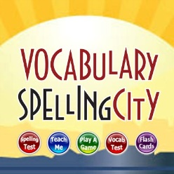
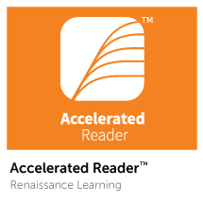
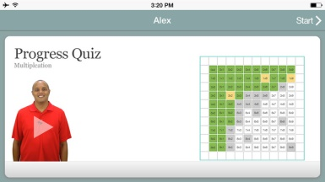
Must Use Apps
* Spelling City
> Must have a subscription to have full access to everything
*AR
>Must have a subscription to use
*Xtra Math
>$4.99 for App, Site is Free
*Brain Pop (Brain Pop Jr, Brain Pop ESL)
>Free video of the week, get the subscription for full access to all videos at any time

Slide 22
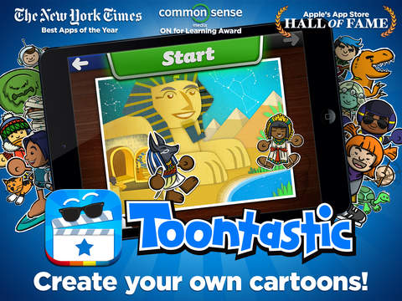
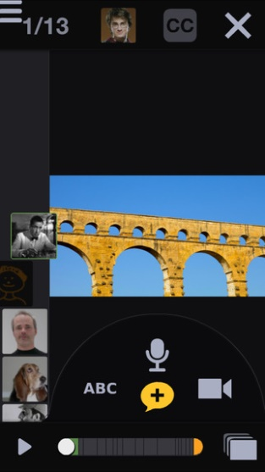
Writers Workshop/Presentation
Puppet Pals- FREE
>Students can animate and record audio to go along with their writing
Sock Puppets- FREE
>Students use sock puppets and their own voice to read
bring their story to life
Toontastic- FREE
> Students can animate and record audio
Voicethread- FREE
> Students can have ‘Book Talks’ and conversations about text that is displayed on the screen.
> They can even draw on the screen and add text to text bubbles.

Slide 23
Writers Workshop/Presentation
Telligami FREE & Paid Version
*See sample on webpage
*Kids LOVE this
* I use for book response & answering comprehension questions
* I have the kids share their Telligami’s using the e-mail option
> Free version- limited clothing & background options
> Record up to 30 seconds of dialog
> Paid Version
> They can even draw on the screen and add text to text bubbles.
> More clothing, avatar, and background options, and longer record time

Slide 24
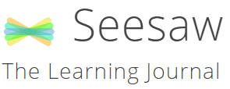
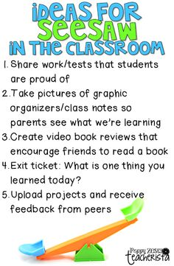
http://web.seesaw.me/
*Student Portfolio
*You decide who has access to work,
individual student’s families or the whole class
*Simple and easy to use
*Students use an iPad to take a picture
of their specially made QR code and
then they take a picture of their work
and it automatically shares it.

Slide 25
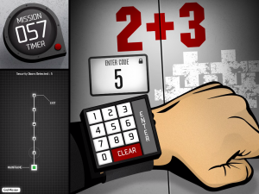
Math Apps
*XtraMath FREE site, $4.99 for app
> site and app for mastery of facts
> made by teachers for students
> www.xtramath.org
*Virtual Manipulatives! Made By: ABCya.com - FREE
> Awesome fraction and decimal manipulatives
*Operation Math $2.99 app
> Master math facts as a spy

Slide 26
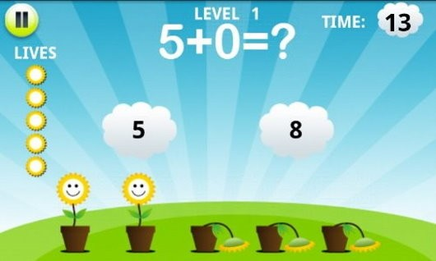
Math Apps
*Math Training for Kids- FREE
>Info from site: “Three difficulty levels and the four basic concepts (addition, subtraction, multiplication, and division) in this simple app that teaches solid math fundamentals will help your child become more skilled.”
* Kids Math - FREE
>Info from site: “The main task here is to pass all eight levels within a certain time frame by answering 10 math questions at each level (including ones about fractions and greater than/smaller than numbers.). Each question allows 30 seconds of answering time; for correct answers, players are rewarded with an additional four seconds. Dynamically generated questioning means that kids get new questions every time they play.”

Slide 27
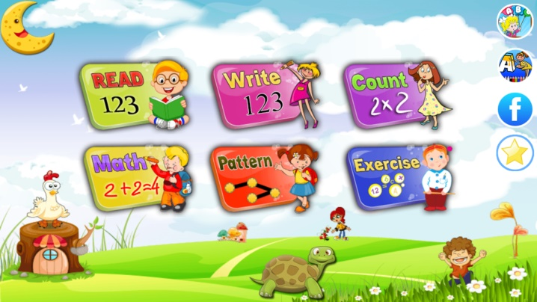
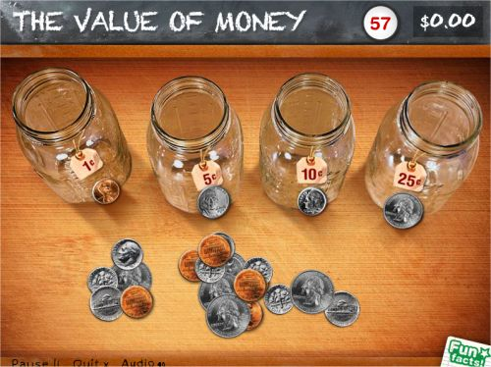
Math Apps
*Preschool Math Games for Kids- FREE
>Info from site: “Young kids will get experience counting, tracing and reading numbers in a fun, interactive way. And don't let the name fool you! This app also features math exercises (addition, subtraction, sequence patterns, and more) for elementary schoolers—up to the 3rd grade level.”
* Peter Pigs Money Counter- FREE
>Info from site: “Developed by Visa, this app helps kids practice sorting, counting, and identifying the value of U.S. coins to earn virtual money. Along the way, Peter Pig (a virtual piggy bank) helps kids learn facts about U.S. currency that are read aloud in a child's voice. ”

Slide 28
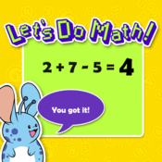
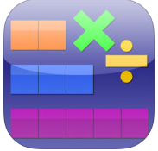
Math Apps
* Let’s Do Math! - FREE
>Info from site: “Keep kids busy for hours with 15 different types of exercises in three categories and 50 word problems that focus on addition and subtraction. The app can be used either as flash cards or as a series of puzzles to teach basic concepts.”
* Thinking Blocks Multiplication - FREE
>Info from site: “Use number blocks to solve multiplication word problems, a strategy supported by Common Core standards. This app introduces kids to six problem solving models, which helps them organize information and visualize number relationships. ”

Slide 29
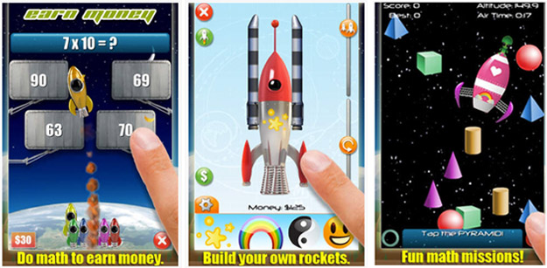
Math Apps
* Mathmateer (Formerly Rocket Math) 99 cents
>Info from site: “Mathmateer, voted one of the top 10 best apps for elementary school kids by Appolicious (the app directory), appeals to kids' creative side. To build a rocket ship to launch into space, kids must earn money by completing basic math challenges while recognizing patterns and shapes, telling time, and working on fractions and square roots.”
> I got mine FREE from Apps Gone Free
> Test out the lite version for FREE with limited access to topics

Slide 30
More Math Apps
>See App List
>Math Stations? Literacy Stations?
>Differentiate Math Time
>Need time to work with a small group for a math intervention?

Slide 31
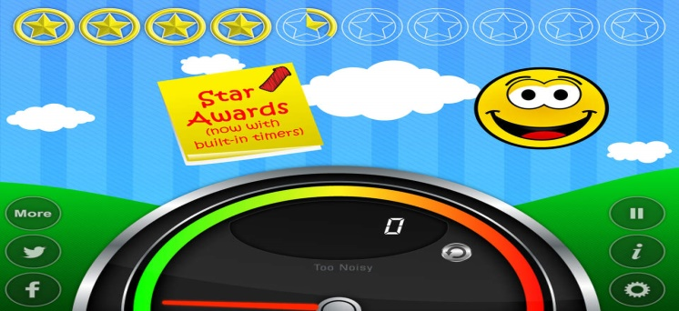
Behavior Management
*Traffic Light! By Gareth Vaughan- FREE
> Tap ‘i’, change it to manual, & choose your light
> I use it at my desk and during reading groups
> I use red to mean ‘no interrupting’/’not open for questions’, yellow
as you may wait in line, green for go ahead and ask- no line
*Too Noisy- FREE or $3.99
> Set the sensitivity of the sound sensor, if the students get too loud the smiley face gets sad

Slide 32
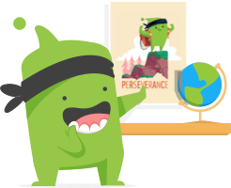
Behavior Management
www.ClassDoJo.com
*Simple, interactive, and effective
*Can be used on ANY mobile device (including smart phones, iPad- there is an app, computer, etc)
*Students can redeem themselves throughout the day
*Optional print out daily or weekly behavior reports per student
*Optional parent access code you can hand out
*Lots of free teacher resources including “Big Idea Videos”
*NEW for 2016: “Class Story” You can post photos, videos, notes in real time! It’s like a safe Facebook for your parents & kids. They can not take the photos and videos off of Class Story.
*They do listen to teacher suggestions!
*SHHH! They haven’t announced this yet. . . New for fall 2016* Individual Student Portfolios (similar to Seesaw) called
“Student Story”

Slide 33
Teacher Resources
*GroovyGrader By Dryrain Technologies- FREE
> It’s a slide grader!
> No more worrying about forgetting or loosing your slide grader
*Running Record Calculator- FREE or $
> Get the paid version to record student voices and save data
> Comes with a timer you can set for 1 minute or more
> Enter the words read, words missed, & words self corrected
> It will give you a WPM read and their % of accuracy

Slide 34
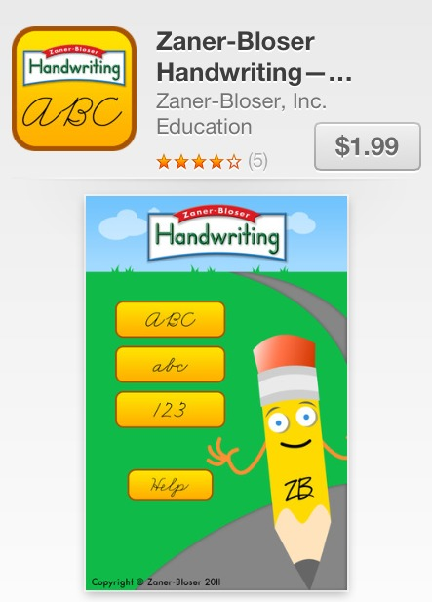
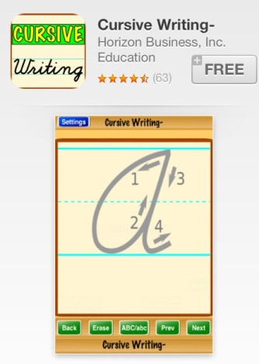
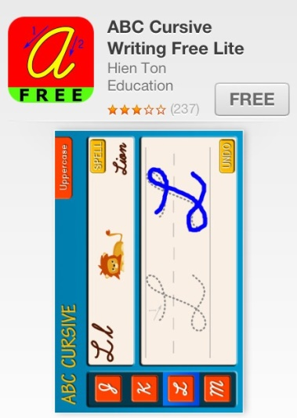
Handwriting-Cursive
*Zaner-Bosser- $1.99
*Cursive Writing- FREE
* ABC Cursive Writing FREE Lite

Slide 35
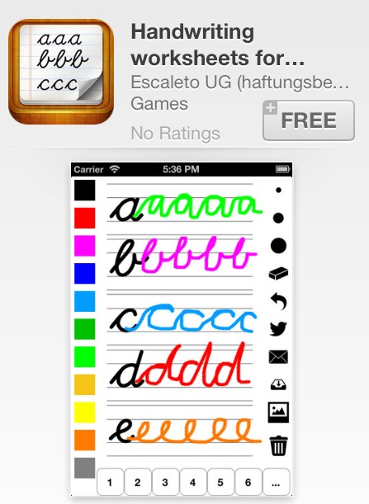
Handwriting-Cursive
*Handwriting Worksheets- FREE

Slide 36
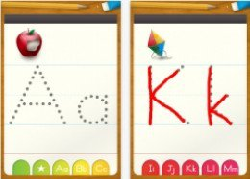
Handwriting - Print
*ABC Letter Tracing Alphabet-FREE

Slide 37
Phonics
*ABC Mouse- FREE
> Site & App are FREE for teachers
> Pre K- K
*Endless Alphabet $4.99-$6.99
> I got it FREE from “Apps Gone Free”
*Articulation Station- FREE
> Info from site: “Articulation Station provides speech professionals, teachers, and parents with ways to help kids improve pronunciation and articulation. Using very specific exercises, games, and stories that focus on just one letter sound for 22 English language sounds, this app can improve pronunciation and understanding of how letter sounds form words. With more than 1,000 target words, kids will likely not get bored with this app. Adults have easy ways to track kids' progress and can track up to six kids at once. Note: To get full use of this app, you have to purchase the Pro version or buy individual letters with an in-app purchase option.”

Slide 38
Phonics
*Learn With Homer- FREE
> Pre K- K
> Info from site: “A learn-to-read app for kids ages 3 to 6 that incorporates drawing, voice recording, stories, songs, and more, along with more traditional phonics exercises. This app can be helpful for kids who have speech production issues and organization of language issues.”
*Sky Fish Phonics- FREE
> Info from site: “Sky Fish Phonics combines logical problem-solving puzzles (think Where's My Water? or Cut the Rope) with multiple-choice, basic reading-skills questions. Kids choose a costume and tap a succession of machines to launch a fish through an increasingly complex obstacle course, answering phonics questions and collecting stars along the way.”

Slide 39
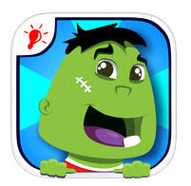
Phonics
*Electric Company Wordball! – FREE
> Info from site: “The Electric Company Wordball is a phonics game that integrates video clips from the TV show to teach reading and spelling. The game consists of two parts: watching a video about a letter sound or letter combination and tapping the "wordballs" with the featured letter or letter combination; then using the collected wordballs to complete words as they move across the screen. The object of the app is to teach lessons about phonics, reading, and spelling.”
*Wonster Words- FREE
> Info from site: “Wonster Words: Spelling with ABC and Phonics uses entertaining, silly videos to introduce young readers to pattern words and word families by having them match letters to their outlines to spell the words on the list. Each list contains eight words that have the same ending pattern or a matching phonic element such as th, sh or ch sounds.”

Slide 40
Beginning Readers
*Pango FREE
> Info from site: “Lets readers drive the story by shaking and touching the characters.”
*PBS Kids- app and site- FREE
> Tons of free interactive games and videos
*Magazines (from Scholastic)
> Free if you have a subscription to Scholastic Reader
>Also check out their awesome online & projectable resources
*See other Apps on “More App List”

Slide 41
Even More Apps
*See other Apps on “More App List”
*Also check out “More Phonics App List”

Slide 42
Contact Information
Amber Ploutz
aploutz@gws.k12.in.us
www.missploutz.weebly.com

