Slide 1
Please go to:
www.
missploutz.
weebly.com
Feel free to look around,
then click on Tech.

Slide 2
Web 2.0 Sites, Apps, Tips, & More
So Many Resources,
So Little Time!

Slide 3
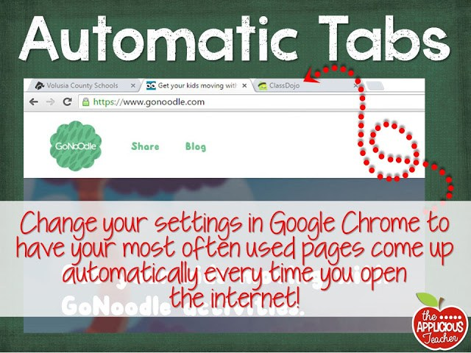
Chrome Automatic Tabs

Slide 4
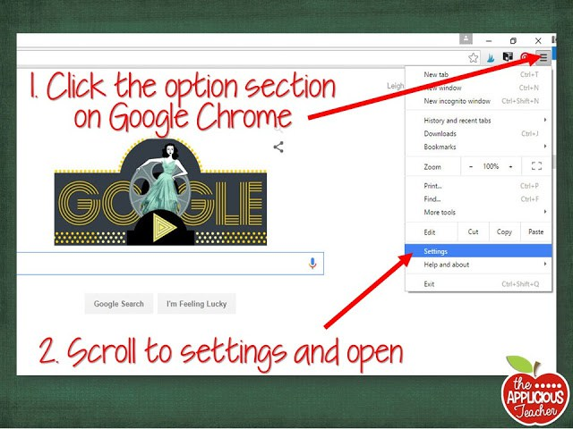

Slide 5
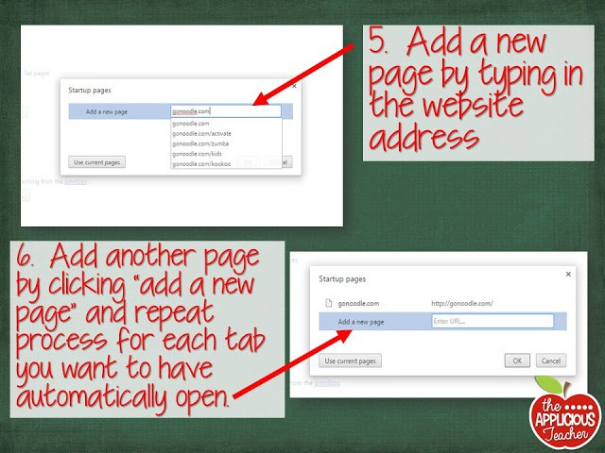
Screenshots from The Applicious Teacher Blog

Slide 6
Create Your own Class Page
www.weebly.com
*Love, love, love this site!
*Simply drag, drop, & type
Font- Did You Know. . .
*Serif- great for large paragraphs and comprehension
Sans Serif-great for titles, no more than a sentence, more decorative

Slide 7
Teacher Must Use
Teacher’s Pay Teachers
www.teacherspayteachers.com
Free Fonts
www.fontspace.com
Donor’s Choose
www.donorschoose.org

Slide 8
Teacher Must Use
Lakeshore Teacher Resources
http://www.lakeshorelearning.com/general_content/free_resources/freeResources.jsp?f=m
Certificates
http://www.123certificates.com/

Slide 9
For Teachers
Reading Graphic Organizers from Scholastic
http://www.scholastic.com/teachers/lesson-plan/graphic-organizers-reading-comprehension
Read, Write, Think
http://www.readwritethink.org/
>Ideas, resources, & videos

Slide 10
For Teachers
Discovery Customizable Word Puzzle
http://www.discoveryeducation.com/free-puzzlemaker/
>Lots of word puzzles to choose from
Projectable Stop Watch
http://www.online-stopwatch.com/full-screen-stopwatch/
>Set to full-screen mode to get rid of some of the ads

Slide 11
Computer Programming
www.code.org
* “Anyone can learn how to code!”
* Variety of levels from Kindergarten
through adult
* High interest topics to engage all students
*Fun way for students to problem solve, work collaboratively, and use difficult math concepts
https://scratch.mit.edu/
*Very similar to Code
*Created by MIT

Slide 12
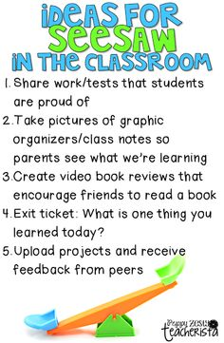
http://web.seesaw.me/
*Student Portfolio using QR Codes
*Get the app
*You decide who has access to work,
individual student’s families or the
whole class
*Simple and easy to use
*Students use an iPad to take a picture
of their specially made QR code and
then they take a picture of their work
and it automatically shares it.

Slide 13
Behavior Management
www.ClassDoJo.com
*Simple, interactive, and effective
*Can be used on ANY mobile device (including smart phones, iPad- there is an app, computer, etc)
*Students can redeem themselves throughout the day
*Optional print out daily or weekly behavior reports per student
*Optional parent access code you can hand out
*Lots of free teacher resources including “Big Idea Videos”
*NEW for 2016: You can post photos, videos, notes in real time! It’s like a safe Facebook for your parents & kids.
*They do listen to teacher suggestions and make updates based on them.
*SHHH! They haven’t announced this yet. . . New for fall 2016* Individual Student Portfolios (similar to See Saw) called
“Student Story”

Slide 14
Behavior Management
https://bouncyballs.org
*Gives a visual representation of the noise level in your room
*You can set how sensitive they are
*You must have your computers
microphone turned on for it to work.

Slide 15
www.gonoodle.com
*Brain Breaks
*Help your students ‘get out the wiggles’ so they can focus on academics
*Usually about 1-3 minutes long
*New material frequently uploaded
*From Zumba to Cool Downs

Slide 16
Go Noodle
Video Clip

Slide 17
Educational Videos
Math Study Jams
http://studyjams.scholastic.com/studyjams/jams/math/index.htm
*LOVE this site
*Videos, math songs, step-by-step problem solving, for grades K- High School
*Great for concept openers and review
PBS Learning Media
http://indiana.pbslearningmedia.org/

Slide 18
Educational Videos
Teacher’s You Tube
www.teachertube.com
You Tube
Sci Show Kids
https://www.youtube.com/user/scishowkids
*Great for K-3, variety of topics, new videos every week
Harry Kindergarten
https://www.youtube.com/user/HarryKindergarten
*Upbeat songs for K-2
*Reading, phonics, math, and science concepts covered
*Check out their sight word songs

Slide 19
Educational Videos
www.tubechop.com
*No login needed
*Chop parts of a YouTube video to get just the part you want to show
* It gives you a link, you can embed or share
www.viewpure.com
*Bye-bye You Tube distractions!
* One of my favorite sites!

Slide 20
Pen Pals
http://www.epals.com/#/connections
* Suggested for grades 3+
*Great to get kids excited about writing and learning about the world

Slide 21
Let’s Get Art-sy!
Crayola Online
http://www.crayola.com/for-educators.aspx
* Lots of free resources for teachers (STEAM)
*New program for recycling old/dried out markers

Slide 22
Virtual Field Trips
*With budgets getting cut more and more Virtual Field Trips are a great and FREE way to build background knowledge and give the a way to experience something new.
*Some of these sites have video and audio clips, some of them have interviews and text to read.
*Some even have live streaming possibilities!

Slide 23
Virtual Field Trips
*Ellis Island Virtual Field Trip/Tour
http://teacher.scholastic.com/activities/immigration/tour/index.htm
*Plimoth Plantation Virtual Field Trip/Tour
http://www.scholastic.com/scholastic_thanksgiving/webcast.htm
>They explain why it isn’t spelled ‘Plymoth”
Discovery Channel
http://www.discoveryeducation.com/Events/virtual-field-trips/explore/index.cfm
>TONS of virtual field trips

Slide 24
Space Virtual Field Trips
http://worldwidetelescope.org/
>Your computer becomes a virtual telescope!
*Tour the Solar System!
http://project-metis.com/
>Option to turn off computer voice narration at the top of screen
*Online Planetarium
http://neave.com/planetarium/
*Explore Mars
http://www.exploremars.org/

Slide 25
Virtual Field Trips
http://www.360cities.net/
>Take virtual tours of thousands of cities across the globe
*9/11 Tribute Center
http://tributewtc.org/
*African Animal Wildlife live streaming
http://www.africam.com/wildlife/
*San Diego Zoo videos and live animal cams
http://zoo.sandiegozoo.org/videos

Slide 26
Virtual Field Trips
http://www.airpano.com/
>Take virtual tours of thousands of cities across the globe
*Explore the Arctic
http://polarhusky.com/
*Explore Ancient Egypt
http://www.eternalegypt.org/EternalEgyptWebsiteWeb/HomeServlet?ee_website_action_key=action.display.home

Slide 27
Art/Museum Virtual Field Trips
*Google Art Project
https://www.google.com/culturalinstitute/project/art-project
*The Louvre
http://www.louvre.fr/
*Natural History Museum
http://naturalhistory.si.edu/
*European Art Museums
http://www.europeanvirtualmuseum.it/

Slide 28
Virtual Field Trips
*Explore the Taj Mahal
http://www.taj-mahal.net/
*Explore Anne Frank’s home
http://annefrank.org/en/subsites/home/

Slide 29
Virtual Field Trips
*Tour the Supreme Court
https://www.oyez.org/tour
*Interactive White House Tour
https://www.whitehouse.gov/about/inside-white-house/interactive-tour
*Live Animal Cams
http://explore.org/live-cams/player/osprey-nest

Slide 30
Interactive Learning
Journey North
http://learner.org/jnorth/
>Awesome learning opportunity!!
>Check out their symbolic butterfly migration
>I’ve had my classes participate for 6 years!

Slide 31
Fun With Words
http://recitethis.com/
>Make your own motivational posters
>Click ‘Download’ for a jpeg file

Slide 32
Fun With Words
www.tagxedo.com
>Perfect for word related projects
>Simple to do and kids LOVE it!
http://bookbuilder.cast.org/
>Sign-up for a free account
>Write and create your own e-books
www.easybib.com
>Citing Work/Bibliographies Made Easy
www.citelighter.com
>Marks things you find on the internet and add notes to it for later use.

Slide 33
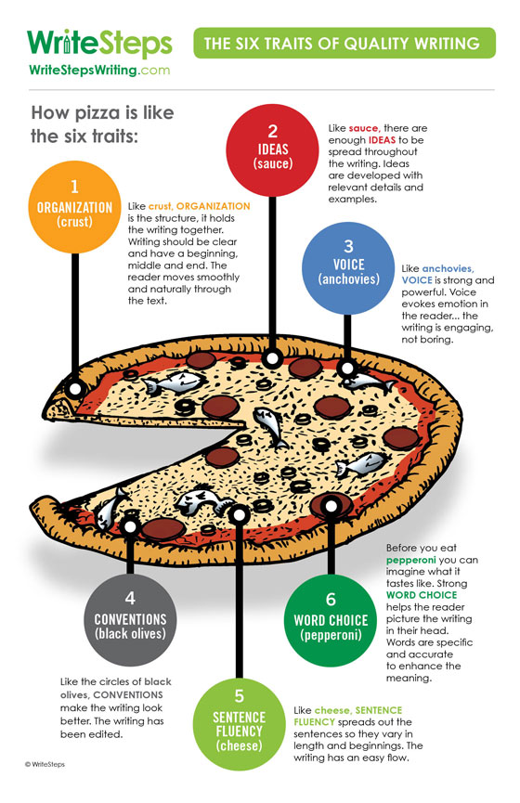
Writers Workshop
http://www.writestepswriting.com/
>Tons of resources and ideas for students
and teachers for Writer’s Workshop
>Sign up for their e-mail newsletter which
also sends free resources monthly

Slide 34
Writers Workshop
https://littlebirdtales.com/
>K-3
>Students create and read their own stories
>You can e-mail the video stories to parents
>Free for teachers
>It will save your story videos for 90 days
http://storybird.com/
>They suggest 3+ independently and K-2 with adult help
>Totally Free!
>Set up assignments for students or let them free write

Slide 35
,mn
Pic Monkey- Photo Editor
http://www.picmonkey.com/
>Create cool headers with class photos for your class web page
>No login
>Free
>Some features you do have to pay for
>See samples on class page

Slide 36
Parent Communication
www.surveymonkey.com
>Unlimited surveys and responses
>Link given to your created survey
>You choice the response option and the number of answers that can be marked

Slide 37
Parent Communication
www.remind101.com
>A free and safe way for teachers to text parents and students.
Class e-mail list
>Make a Parent Contact group
>To: Yourself
BCC: Parent Contact List

Slide 38
Interactive Awesomeness
www.socrative.com
Teacher Login: t.socrative.com
Student Login: m.socrative.com
Room: 277485 *For Sample
*Now it’s an app!!
>It works the same way as the site
>Make sure that you have the “Student App” on their
iPads and the “Teacher App” on YOUR iPad

Slide 39
Interactive Awesomeness
www.padlet.com
>See Sample
>Double click to add a note
www.nearpod.com
>For use with older kids
>Tons of premade lessons
>They do charge for some features
>Also an app

Slide 40
Save & Access Your Work
Any & Everywhere
www.dropbox.com

Slide 41
Math-Mazing!
Xtra Math
www.xtramath.org
>site – FREE, app $4.99
Math Manipulatives
http://nlvm.usu.edu/en/nav/vlibrary.html
>Math Manipulatives and games for every grade level

Slide 42
Reading Websites
Into the Book
http://reading.ecb.org/
>Practice reading comprehension strategies
>For teachers and students
Youngzine
http://www.youngzine.org/
>Kid-friendly news articles
www.dropeverythingandread.com
>Lots of Beverly Cleary Resources

Slide 43
Scholastic Online
http://magazines.scholastic.com/
>Awesome articles for kids about current happenings
>You don’t need a subscription to access these resources!
>Check out “Road to the White House”
>Scholastic Book Clubs are also online
>If you have a subscription to Scholastic Magazines, you also have access to free online magazines with TONS of extras.

Slide 44
Reading Websites
Storyline
www.storylineonline.net
>Celebrities read high quality children’s literature
>Created by the Screen Actor’s Guild
>All stories are AR
ABC Ya
www.abcya.com
>Reading and math skill games
www.seussville.com
>Read and play Dr. Seuss games

Slide 45
Authors & Book Series
Just about every author and book series has their own website.
www.magictreehouse.com
>My students love the adventures that correspond to each book in the series
http://www.shelsilverstein.com/
Magic School Bus
http://www.scholastic.com/magicschoolbus/games/index.htm

Slide 46
Other Sites
Scholastic
http://teacher.scholastic.com/activities/clf/tguidesitemap.htm
Math Manipulatives
http://www.eduplace.com/kids/mw/
Highlights
http://www.highlightskids.com/
>You don’t need a subscription to access the resources
Simple Phonics Games
http://www.sadlier-oxford.com/phonics/student.cfm
Starfall
http://www.starfall.com/
>Good for preschool- early 1st

Slide 47
Other Sites
Fuel The Brain
http://www.fuelthebrain.com/
>Games, pintables, & More
E-Learning
http://www.e-learningforkids.org/
>Tons of interactive lessons
Wonderopolis
http://wonderopolis.org/
*Kids ask questions and they answer them
Fun Fonix
http://www.funfonix.com/
>Customizable phonics worksheets

Slide 48
History/Social Studies
http://www2.ed.gov/free/index.html
>Photos, video clips, and more from the US government
>New content added every month
>Geared towards older students
Government for Kids
https://kids.usa.gov/
>Lots of great resources!
Smithsonian for Teachers
http://www.si.edu/Educators
Smithsonian for Students
http://www.smithsonianeducation.org/students/

Slide 49
Science
National Science Teachers Association
http://www.nsta.org/
Water Cycle Diagram
http://earthguide.ucsd.edu/earthguide/diagrams/watercycle/
Earthquakes for Kids
http://earthquake.usgs.gov/learn/kids/
Dino Directory
http://www.nhm.ac.uk/nature-online/life/dinosaurs-other-extinct-creatures/dino-directory/top-5/top-5.html

Slide 50
Science
Education in Nature
http://educationinnature.com/Educator-Center
>Lessons, activities, videos, for grades K-5
Switcheroo Zoo
http://www.switcheroozoo.com/
>Videos, passages, games and more
>Check out “Build a Biome”
National Geographic Kids
http://kids.nationalgeographic.com/
>You don’t need a subscription to access the content

Slide 51
Science/Social Studies
Scientific Method Rap
http://www.mathgametime.com/videos/the-scientific-method-rap
Printable Outline Maps
http://www.eduplace.com/ss/maps/
National Geographic Interactive Maps
http://education.nationalgeographic.com/education/mapping/?ar_a=1&force_AR=True
50 States
http://www.50states.com/
>Tons of info about each state
>Does have a lot of ads on it

Slide 52
Ribbit Resources
*Check out the Ribbit Resources Tab

Slide 53
Oh, so many Apps!

Slide 54
All About Your iPad
*Show Me on an Apple – FREE
*Made by Living Paper FREE, LLC.
*Also a site: www.showmeonapple.com
*Videos explain how to do various tasks and using your apple product
*Site has more videos

Slide 55
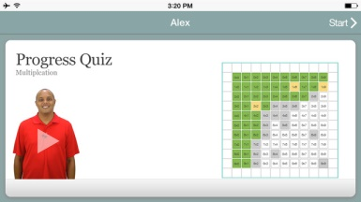
Must Use Apps
* Spelling City
> Must have a subscription to have full access to everything
*AR
>Must have a subscription to use
*Xtra Math
>$4.99 for App, Site is Free
*Brain Pop (Brain Pop Jr, Brain Pop ESL)
>Free video of the week, get the subscription for full access to all videos at any time

Slide 56
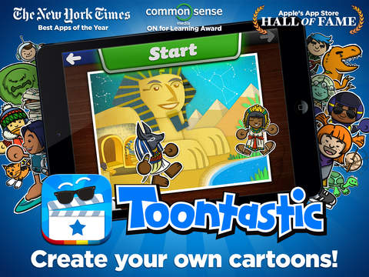
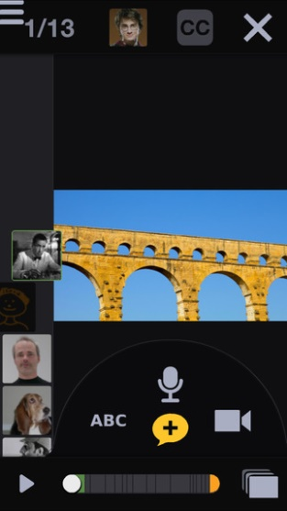
Writers Workshop/Presentation
Puppet Pals- FREE
>Students can animate and record audio to go along with their writing
Sock Puppets- FREE
>Students use sock puppets and their own voice to read
bring their story to life
Toontastic- FREE
> Students can animate and record audio
Voicethread- FREE
> Students can have ‘Book Talks’ and conversations about text that is displayed on the screen.
> They can even draw on the screen and add text to text bubbles.

Slide 57
Writers Workshop/Presentation
Telligami FREE & Paid Version
*See sample on webpage
*Kids LOVE this
* I use for book response & answering comprehension questions
* I have the kids share their Telligami’s using the e-mail option
> Free version- limited clothing & background options
> Record up to 30 seconds of dialog
> Paid Version
> They can even draw on the screen and add text to text bubbles.
> More clothing, avatar, and background options, and longer record time

Slide 58
http://web.seesaw.me/
>Student Portfolio
>You decide who has access to work,
individual student’s families or the whole class
>Simple and easy to use
>Students use an iPad to take a picture
of their specially made QR code and
then they take a picture of their work
and it automatically shares it.

Slide 59
Math Apps
*XtraMath FREE site, $4.99 for app
> site and app for mastery of facts
> made by teachers for students
> www.xtramath.org
*Virtual Manipulatives! Made By: ABCya.com - FREE
> Awesome fraction and decimal manipulatives
*Operation Math $2.99 app
> Master math facts as a spy

Slide 60
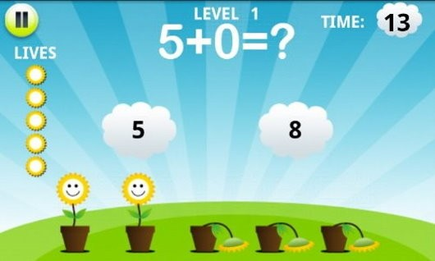
Math Apps
*Math Training for Kids- FREE
>Info from site: “Three difficulty levels and the four basic concepts (addition, subtraction, multiplication, and division) in this simple app that teaches solid math fundamentals will help your child become more skilled.”
* Kids Math - FREE
>Info from site: “The main task here is to pass all eight levels within a certain time frame by answering 10 math questions at each level (including ones about fractions and greater than/smaller than numbers.). Each question allows 30 seconds of answering time; for correct answers, players are rewarded with an additional four seconds. Dynamically generated questioning means that kids get new questions every time they play.”

Slide 61
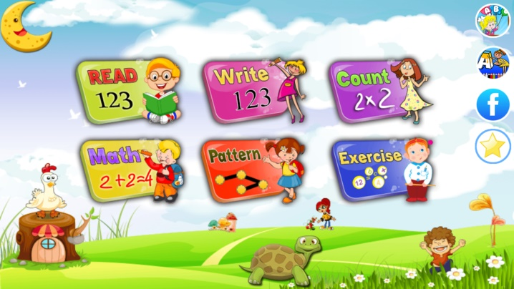
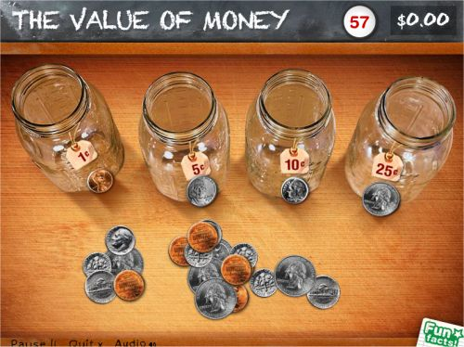
Math Apps
*Preschool Math Games for Kids- FREE
>Info from site: “Young kids will get experience counting, tracing and reading numbers in a fun, interactive way. And don't let the name fool you! This app also features math exercises (addition, subtraction, sequence patterns, and more) for elementary schoolers—up to the 3rd grade level.”
* Peter Pigs Money Counter- FREE
>Info from site: “Developed by Visa, this app helps kids practice sorting, counting, and identifying the value of U.S. coins to earn virtual money. Along the way, Peter Pig (a virtual piggy bank) helps kids learn facts about U.S. currency that are read aloud in a child's voice. ”

Slide 62
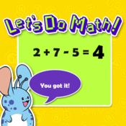
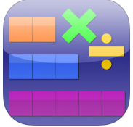
Math Apps
* Let’s Do Math! - FREE
>Info from site: “Keep kids busy for hours with 15 different types of exercises in three categories and 50 word problems that focus on addition and subtraction. The app can be used either as flash cards or as a series of puzzles to teach basic concepts.”
* Thinking Blocks Multiplication - FREE
>Info from site: “Use number blocks to solve multiplication word problems, a strategy supported by Common Core standards. This app introduces kids to six problem solving models, which helps them organize information and visualize number relationships. ”

Slide 63
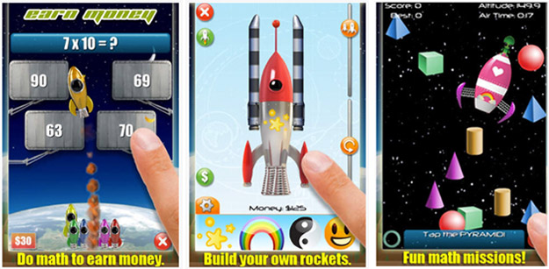
Math Apps
* Mathmateer (Formerly Rocket Math) 99 cents
>Info from site: “Mathmateer, voted one of the top 10 best apps for elementary school kids by Appolicious (the app directory), appeals to kids' creative side. To build a rocket ship to launch into space, kids must earn money by completing basic math challenges while recognizing patterns and shapes, telling time, and working on fractions and square roots.”
> I got mine FREE from Apps Gone Free
> Test out the lite version for FREE with limited access to topics

Slide 64
More Math Apps
>See App List
>Math Stations? Literacy Stations?
>Differentiate Math Time
>Need time to work with a small group for a math intervention?

Slide 65
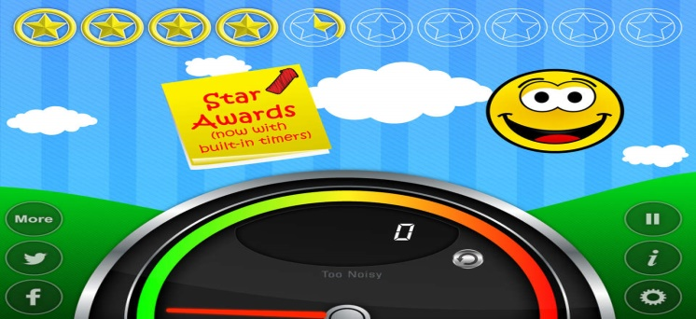
Behavior Management
*Traffic Light! By Gareth Vaughan- FREE
> Tap ‘i’, change it to manual, & choose your light
> I use it at my desk and during reading groups
> I use red to mean ‘no interrupting’/’not open for questions’, yellow
as you may wait in line, green for go ahead and ask- no line
*Too Noisy- FREE or $3.99
> Set the sensitivity of the sound sensor, if the students get too loud the smiley face gets sad

Slide 66
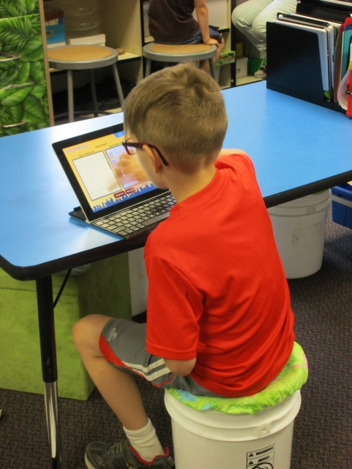
Teacher Resources
*GroovyGrader By Dryrain Technologies- FREE
> It’s a slide grader!
> No more worrying about forgetting or loosing your slide grader
*Running Record Calculator- FREE or $
> Get the paid version to record student voices and save data
> Comes with a timer you can set for 1 minute or more
> Enter the words read, words missed, & words self corrected
> It will give you a WPM read and their % of accuracy

Slide 67
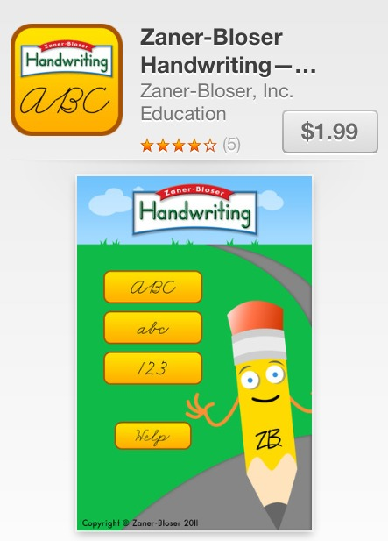
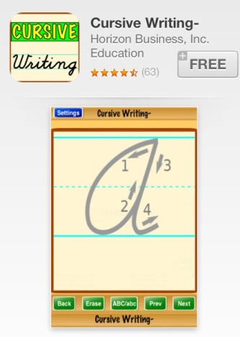
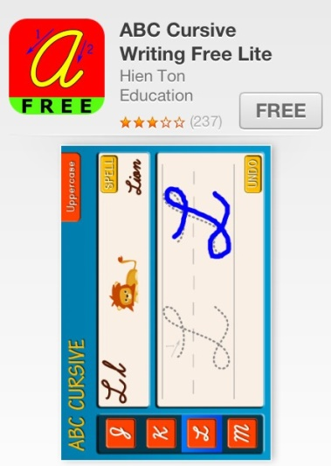
Handwriting-Cursive
*Zaner-Bosser- $1.99
*Cursive Writing- FREE
* ABC Cursive Writing FREE Lite

Slide 68
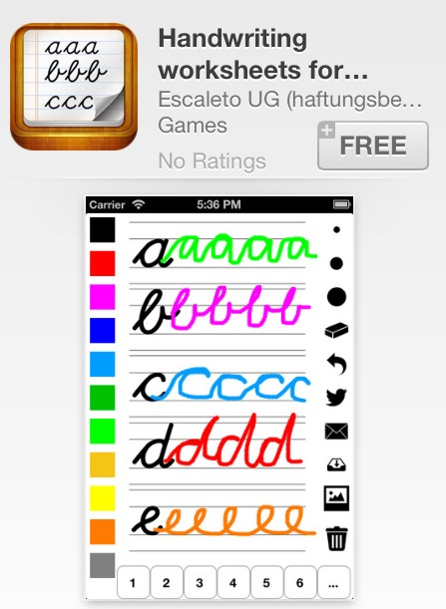
Handwriting-Cursive
*Handwriting Worksheets- FREE

Slide 69
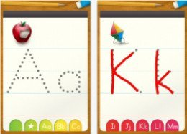
Handwriting - Print
*ABC Letter Tracing Alphabet-FREE
>See “More Apps List” for more handwriting apps
>Also check out ‘art apps’

Slide 70
Phonics
*ABC Mouse- FREE
> Site & App are FREE for teachers
> Pre K- K
*Endless Alphabet $4.99-$6.99
> I got it FREE from “Apps Gone Free”
*Articulation Station- FREE
> Info from site: “Articulation Station provides speech professionals, teachers, and parents with ways to help kids improve pronunciation and articulation. Using very specific exercises, games, and stories that focus on just one letter sound for 22 English language sounds, this app can improve pronunciation and understanding of how letter sounds form words. With more than 1,000 target words, kids will likely not get bored with this app. Adults have easy ways to track kids' progress and can track up to six kids at once. Note: To get full use of this app, you have to purchase the Pro version or buy individual letters with an in-app purchase option.”

Slide 71
Phonics
*Learn With Homer- FREE
> Pre K- K
> Info from site: “A learn-to-read app for kids ages 3 to 6 that incorporates drawing, voice recording, stories, songs, and more, along with more traditional phonics exercises. This app can be helpful for kids who have speech production issues and organization of language issues.”
*Sky Fish Phonics- FREE
> Info from site: “Sky Fish Phonics combines logical problem-solving puzzles (think Where's My Water? or Cut the Rope) with multiple-choice, basic reading-skills questions. Kids choose a costume and tap a succession of machines to launch a fish through an increasingly complex obstacle course, answering phonics questions and collecting stars along the way.”

Slide 72
Phonics
*Electric Company Wordball! – FREE
> Info from site: “The Electric Company Wordball is a phonics game that integrates video clips from the TV show to teach reading and spelling. The game consists of two parts: watching a video about a letter sound or letter combination and tapping the "wordballs" with the featured letter or letter combination; then using the collected wordballs to complete words as they move across the screen. The object of the app is to teach lessons about phonics, reading, and spelling.”
*Wonster Words- FREE
> Info from site: “Wonster Words: Spelling with ABC and Phonics uses entertaining, silly videos to introduce young readers to pattern words and word families by having them match letters to their outlines to spell the words on the list. Each list contains eight words that have the same ending pattern or a matching phonic element such as th, sh or ch sounds.”

Slide 73
Beginning Readers
*Pango FREE
> Info from site: “Lets readers drive the story by shaking and touching the characters.”
*PBS Kids- app and site- FREE
> Tons of free interactive games and videos
*Magazines (from Scholastic)
> Free if you have a subscription to Scholastic Reader
>Also check out their awesome online & projectable resources
*See other Apps on “More App List”

Slide 74
Even More Apps
*See other Apps on “More App List”
*Also check out “More Phonics App List”

Slide 75
Contact Information
Amber Ploutz
aploutz@gws.k12.in.us
www.missploutz.weebly.com

